Slide 2
"Limiting global warming to 1.5°C would require rapid, far-reaching and unprecedented changes in all aspects of society" - IPCC
Notes:
300M in other regions on the globe have the same issue

Slide 3
WE NEED TO PLAN NOT ONLY OPERATIONS BUT ALSO INVESTMENTS
AFFORDABLE
RELIABLE
SUSTAINABLE
"Engineers working on plans, 1959" by Seattle Municipal Archives is licensed under CC BY 2.0

Slide 4
Global Independent Research Initiative
High resolution
Open
Collaborative
Help sustaining
Support
developers
Creating open
data
Predicting
data
ENERGY SYSTEM MODELS
USER AND DEVELOPER COMMUNITY
SOLVER
Features
Performant
DATA
Dialogue
Reveal
bottlenecks
Initiate new paths
Data
workflow
High resolution
Problem
formulator
Modular
Training
Empower
Notes:
OPEN:
- To avoid information asymetries industry and policy
TOGETHER means:
1 model to cover the world
1 modular architecture to allow parallel work and improvement
BENEFITS OF WORKING TOGETHER:
- Faster development
- Improvements have global impact
- Less documentation per person
Everyone can earn maintainership

Slide 5
VISION
Create TOGETHER useful alternatives to closed-source energy system models
for industry and research
Notes:
OPEN:
- To avoid information asymetries industry and policy
TOGETHER means:
1 model to cover the world
1 modular architecture to allow parallel work and improvement
BENEFITS OF WORKING TOGETHER:
- Faster development
- Improvements have global impact
- Less documentation per person
Everyone can earn maintainership

Slide 6
Q&A
15min
1.
THE PYPSA MEETS EARTH INITIATIVE
III.
DEALING WITH MISSING DATA
V.
PANEL DISCUSSION
"THE ENERGY SYSTEM MODELLING CHALLENGES AND OPPORTUNITIES OF THE 21 CENTURY"
II.
THE PYPSA-AFRICA PROTOTYPE PRESENTATION
Q&A
15min
IV.
]HOW TO GET INVOLVED IN OUR EARTH-MISSION

Slide 7
1.
THE PYPSA MEETS EARTH INITIATIVE
II.
THE PYPSA-AFRICA PROTOTYPE PRESENTATION

Slide 8
THE PROBLEM
AFRICA IS DARK!

Slide 9
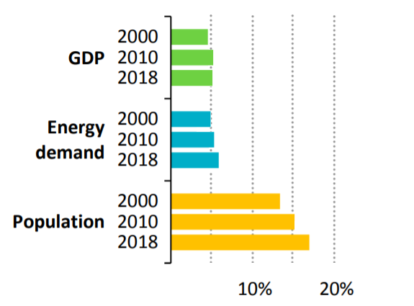
PROBLEM WILL GROW
Per capita indicators shall increase …
… and population is growing …
IEA, Africa Energy Outlook, 2019
Notes:
Average Africa energy consumption: 4.2MWh/pp
World energy consumption: 20.9 MWh/pp

Slide 10
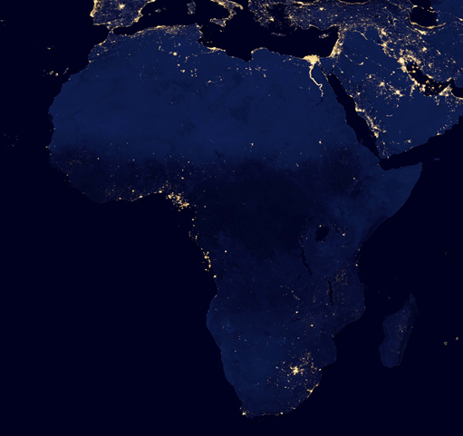
PLANNING FOR A BRIGHT FUTURE
TOOLS FOR:
Policy analysis
Investment analysis
Continent-wide synergies
Decarbonization pathways

Slide 11
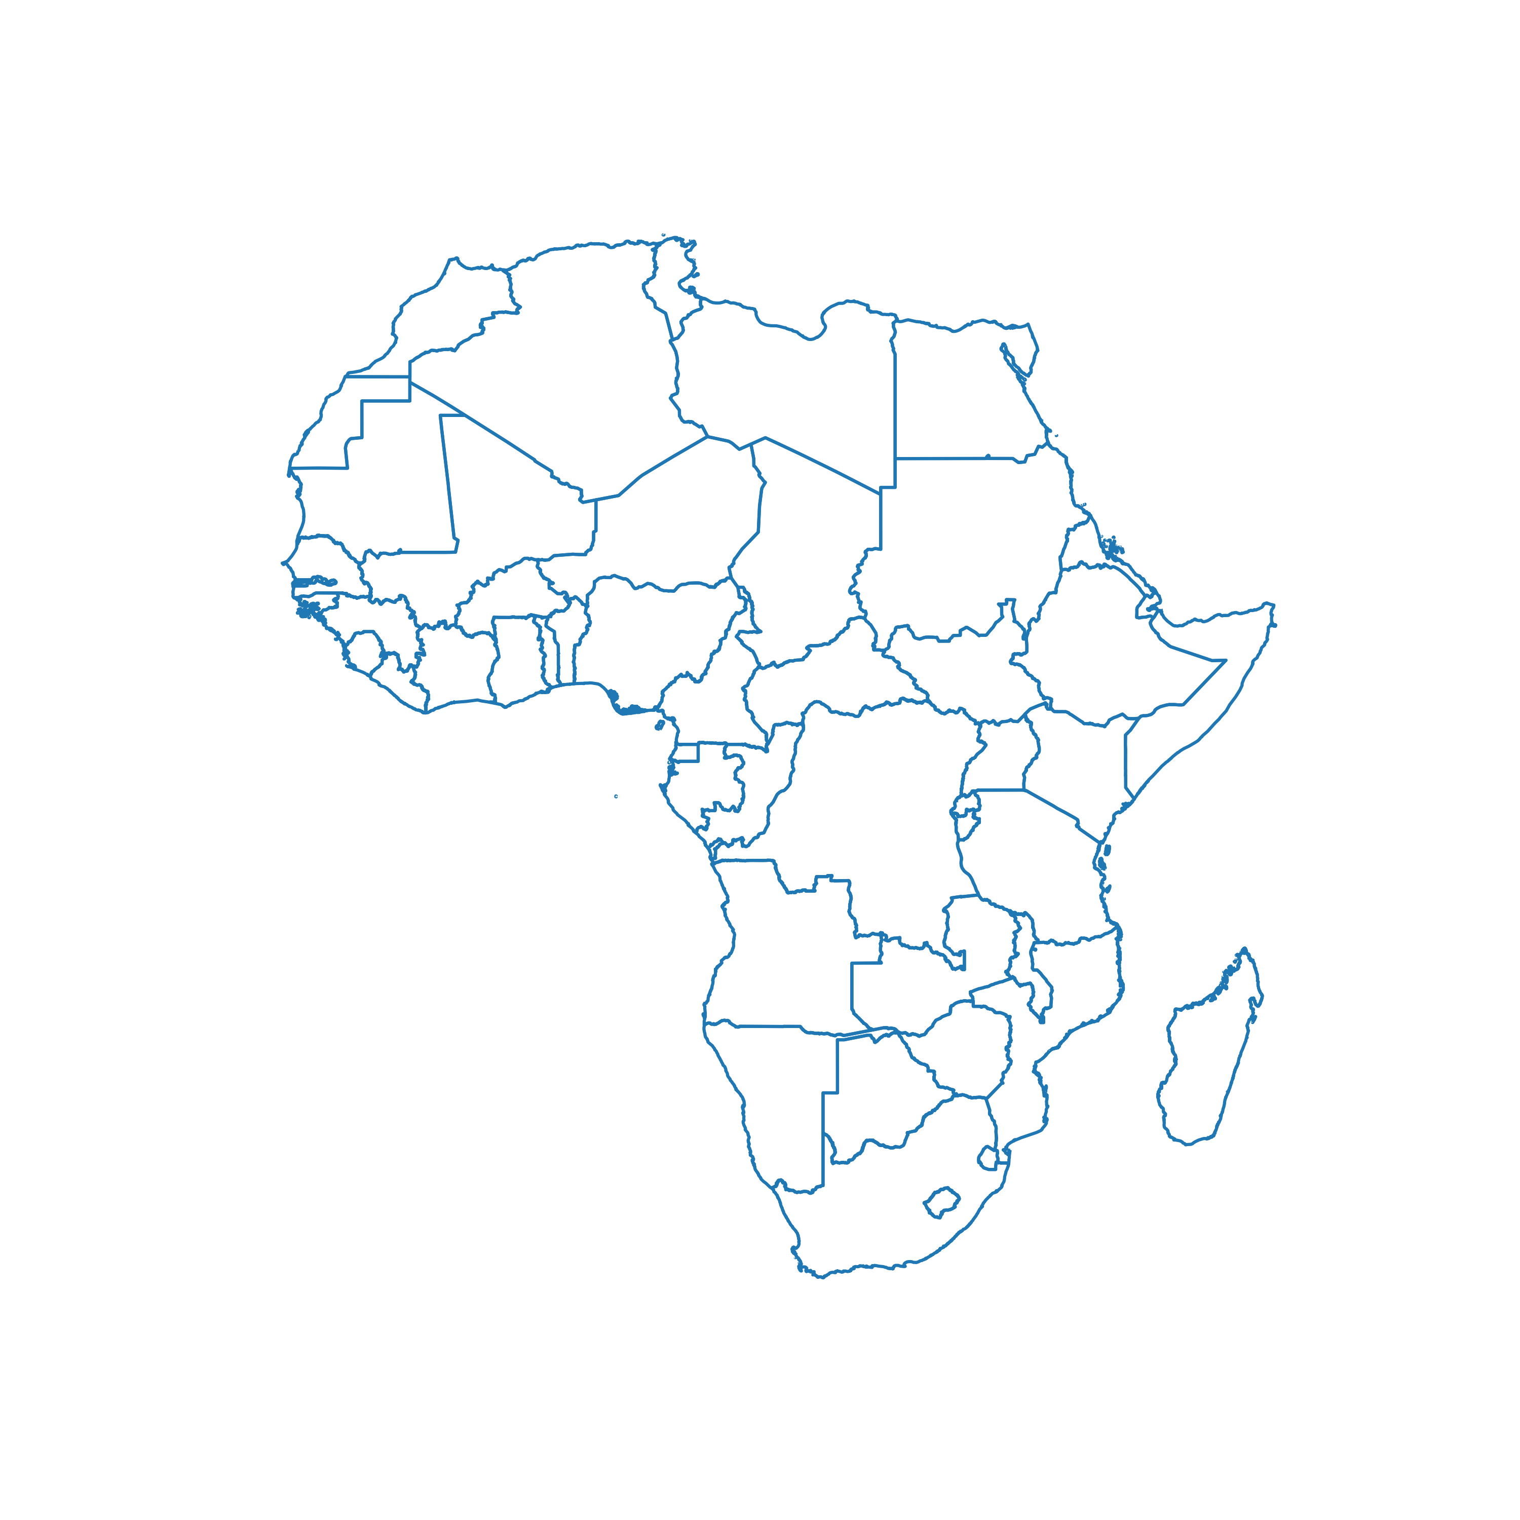
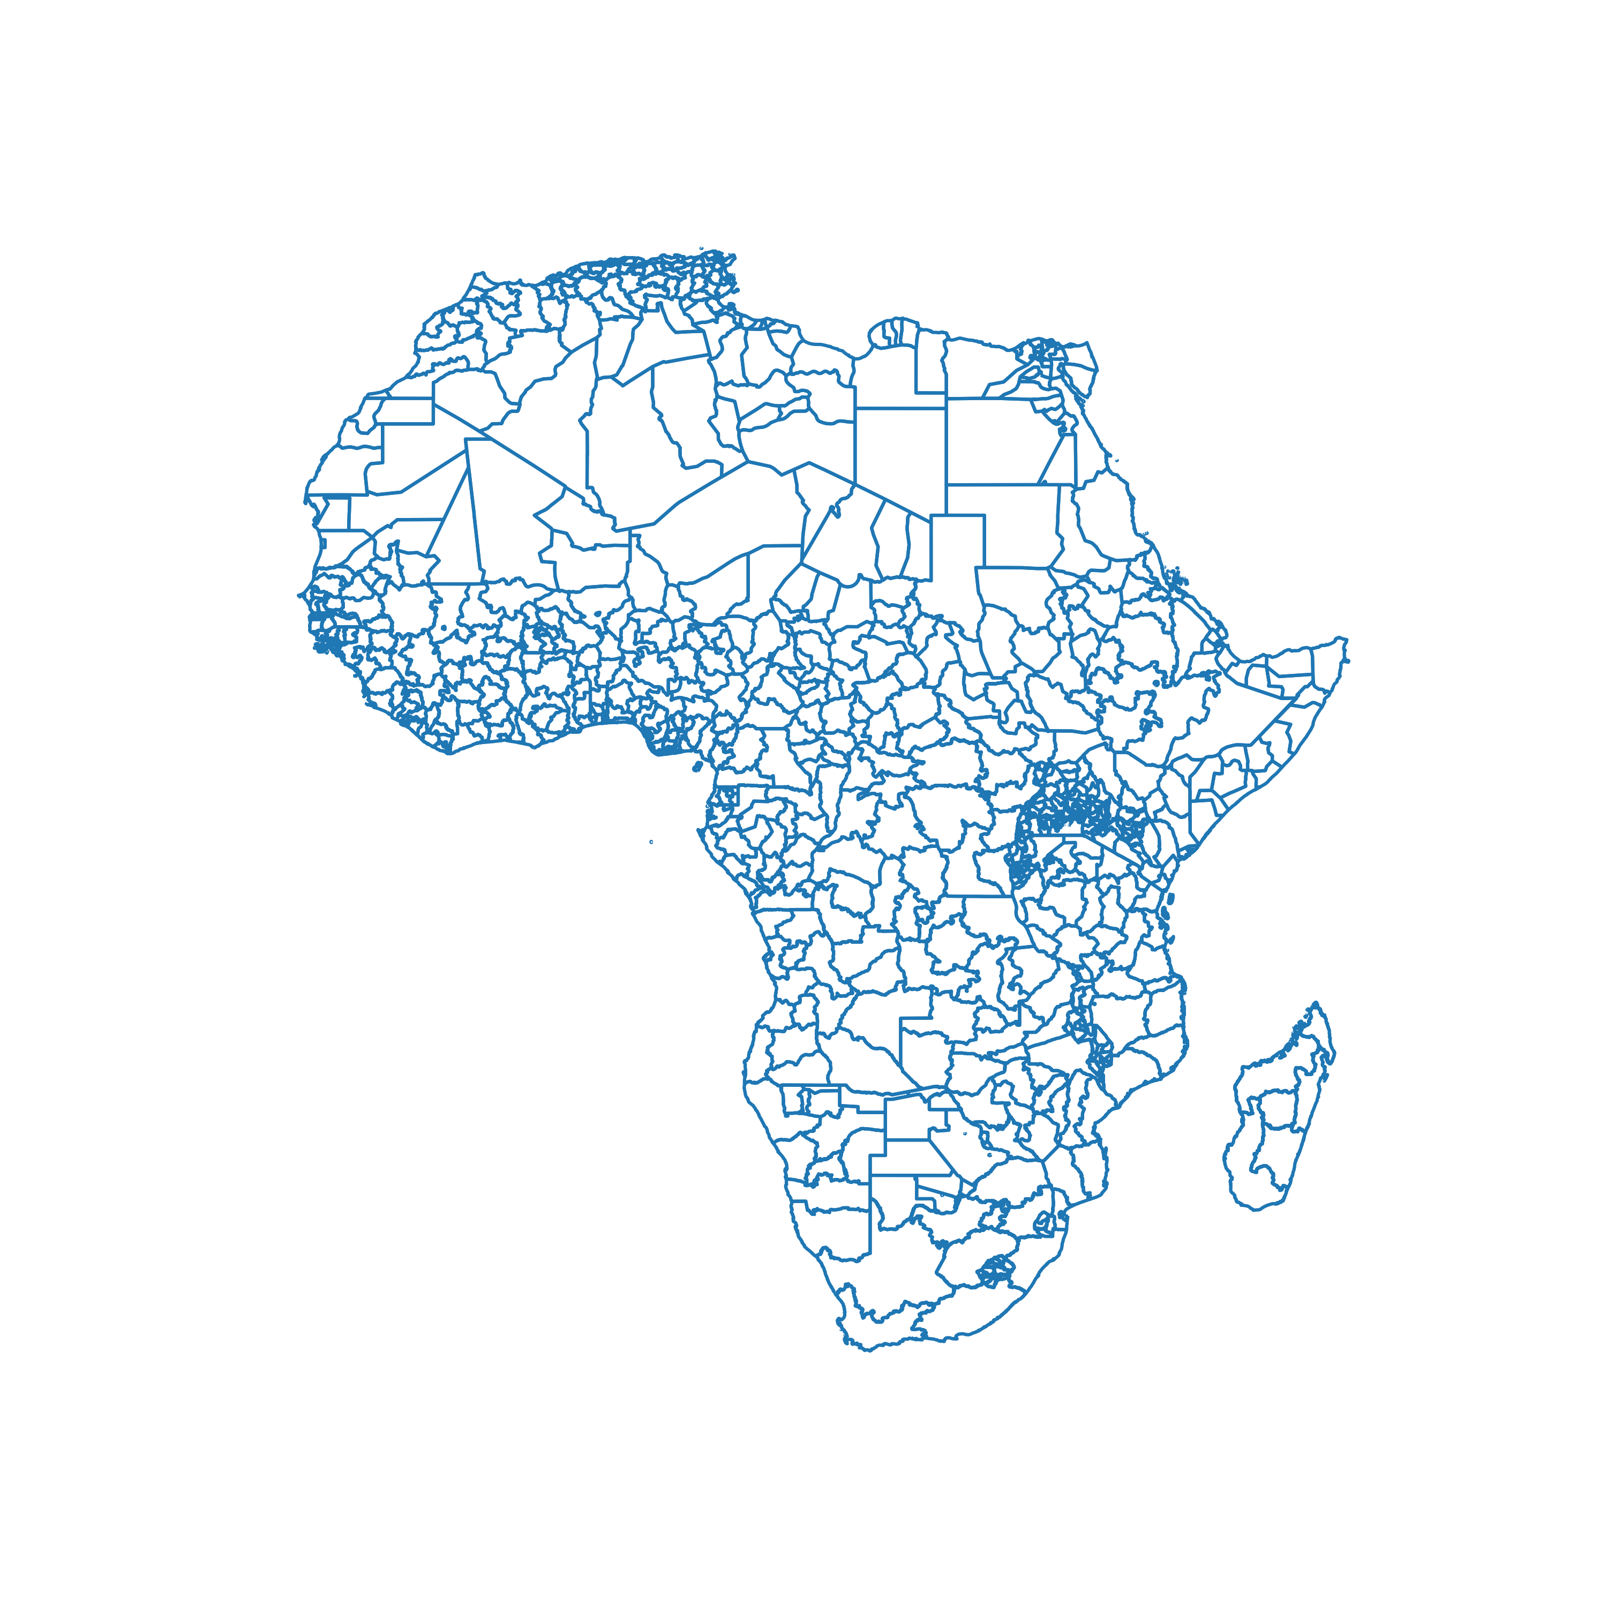
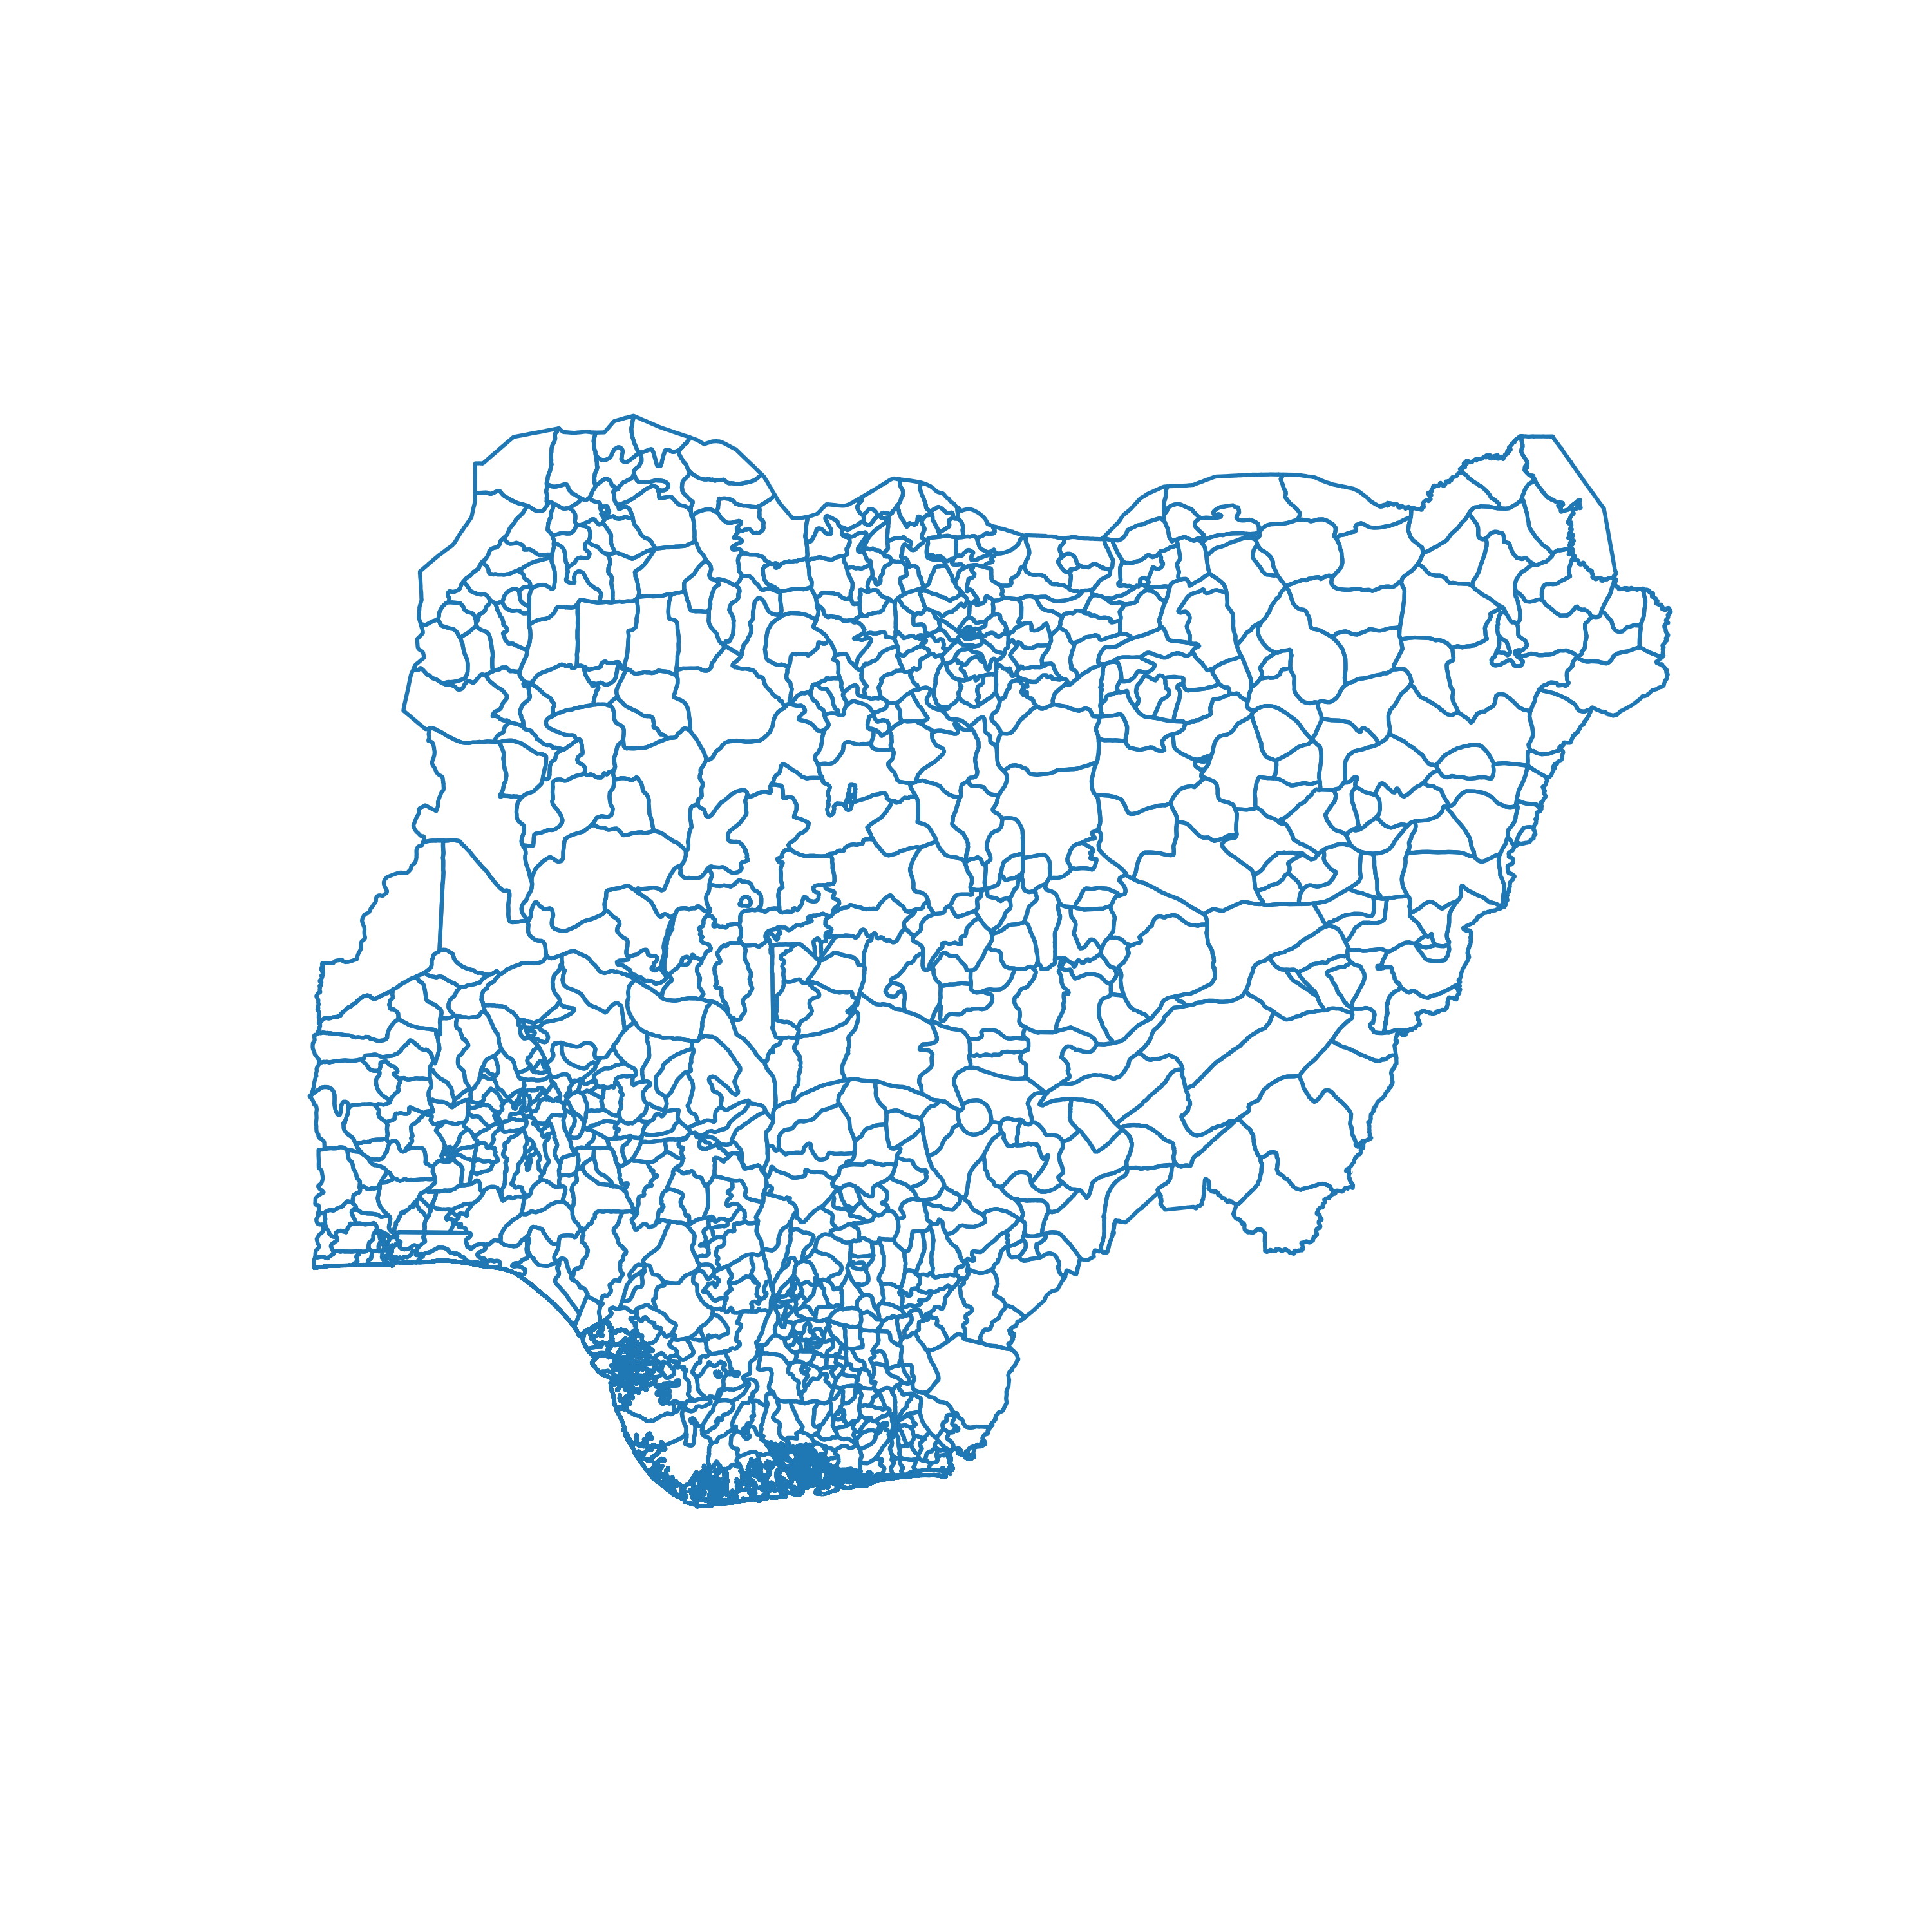
ROLE OF PYPSA
Standard models
PyPSA-Africa
Country resolution
Flexible resolution
Flexible scope
Nigeria case
Notes:
Flexible spatial and time resolution
Credits to PyPSA-Eur

Slide 12
PYPSA-AFRICA FEATURES
Policy makers and utilities need:
Robust
Low cost
Reliable
Easy-to-use
Planning & dispatch tools

Slide 13
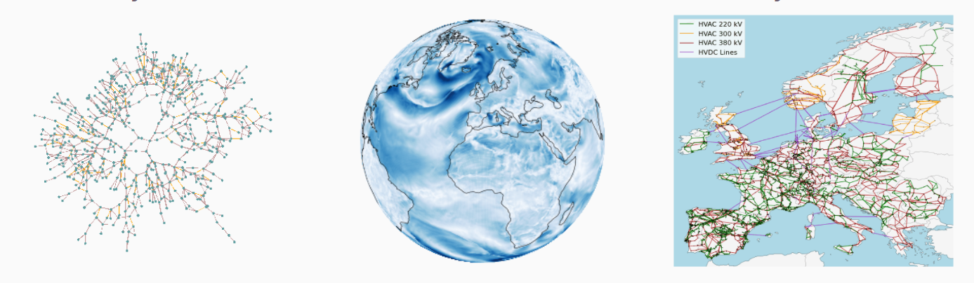
PYPSA-AFRICA FEATURES
Policy makers and utilities need:
Robust
Low cost
Reliable
Easy-to-use
Planning & dispatch tools
Built on top of PyPSA-Eur, …
Open-source model
Community support (>60pp)
Credits also to
Scenario analysis
Adjustable resolution
Sector-coupling (coming soon)
PyPSA
Atlite
PyPSA-Eur

Slide 14
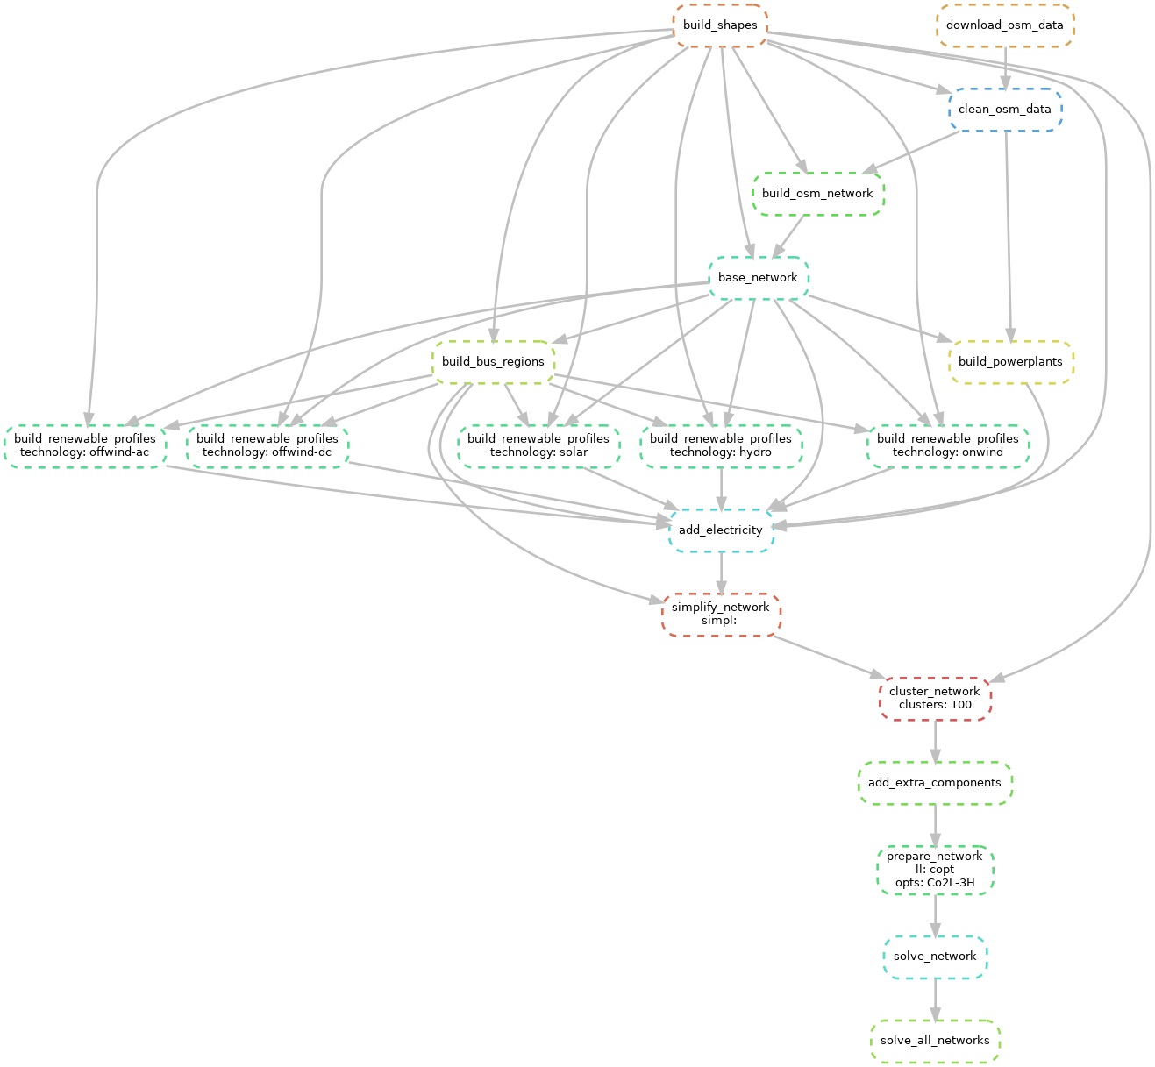
HOW IT WORKS
Config file
Data processing
Download data
Automated workflow
Filter data
Combine data
Create model
Solve
Results
Notes:
Given the configuration files and the scenarios to draw, workflow(snakemake) execute only once the scripts needed starting from raw data.
This means efficiency, flexibility and easy to use

Slide 15
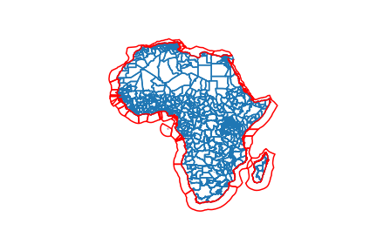
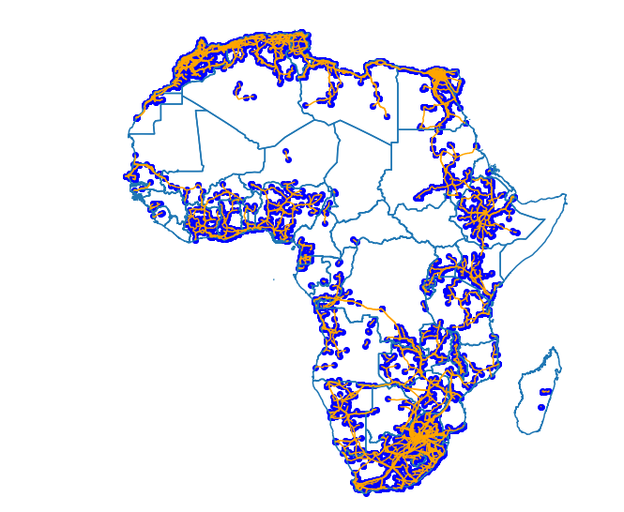
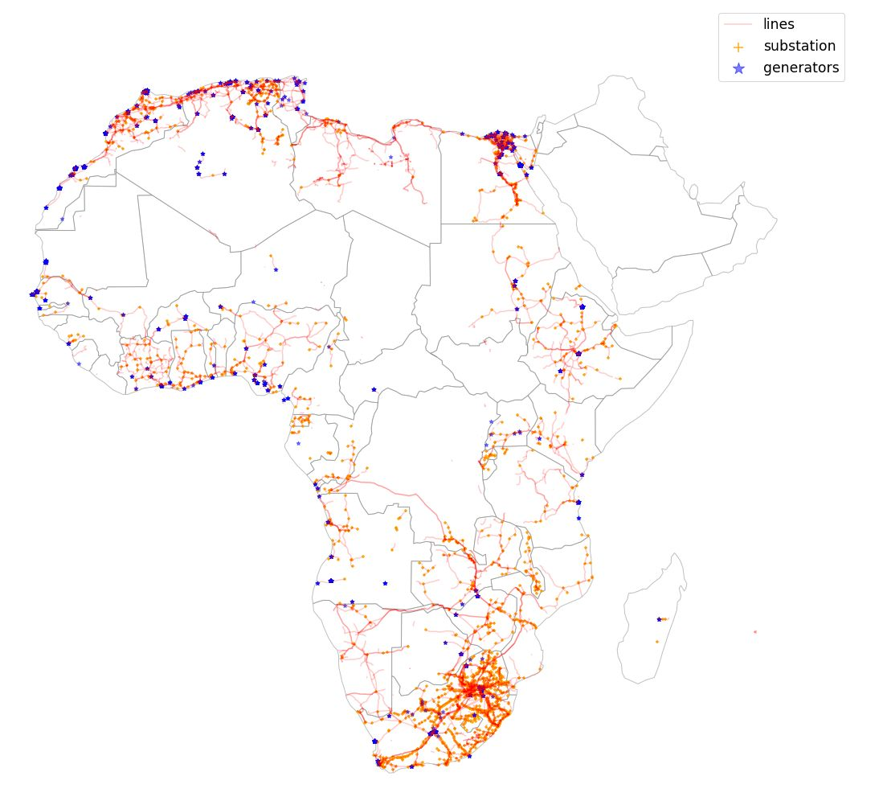
DATA PROCESSING
Open-source datasets:
OpenStreetMap (OSM)
Database of Global Administrative Areas (GADM)
ERA5 from Copernicus Climate Change Service
….
Download data
Filter data
Combine data
Accurate network description
Demand and renewable by region
GDP, Population, RES.
…
Network data

Slide 16
DEEP DIVE THE PYPSA-AFRICA PROTOTYPE
Network data by Open Street Map
Powerplant data
Renewables and demand assessment
Clustering to deal with complexity
Network augmentation
Some results

Slide 17
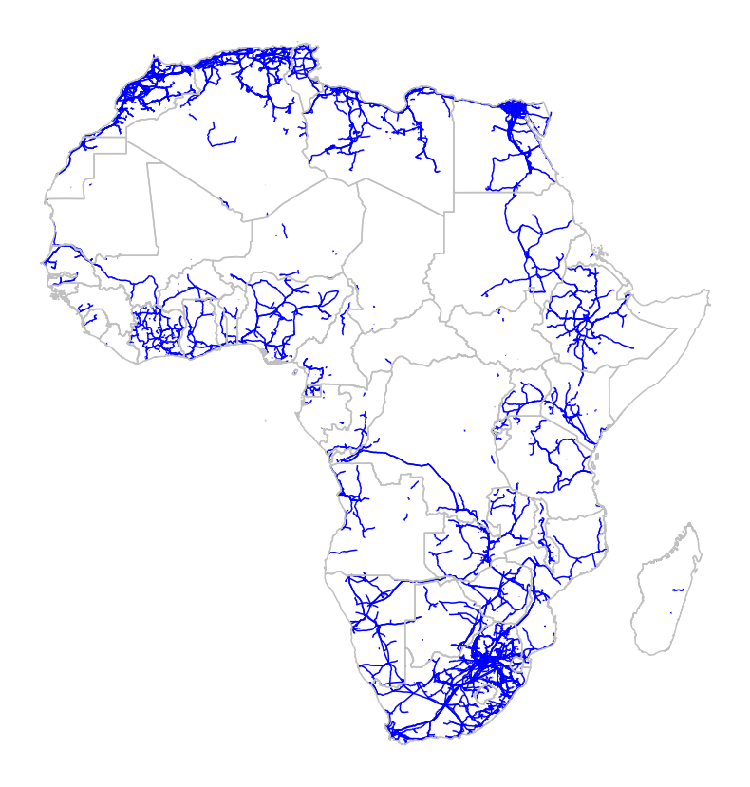
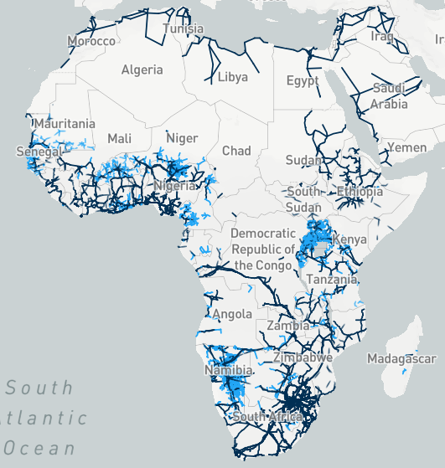
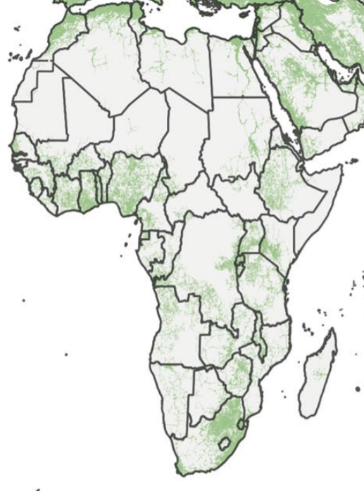
NETWORK DATA Openstreetmap
For the African continent …
Good but improvements needed
countries: ["africa"]
Estimate by AI
Picture by Hazem Abdel-Khalek
https://africagrid.energydata.info/
Arderne et al. 2020

Slide 18
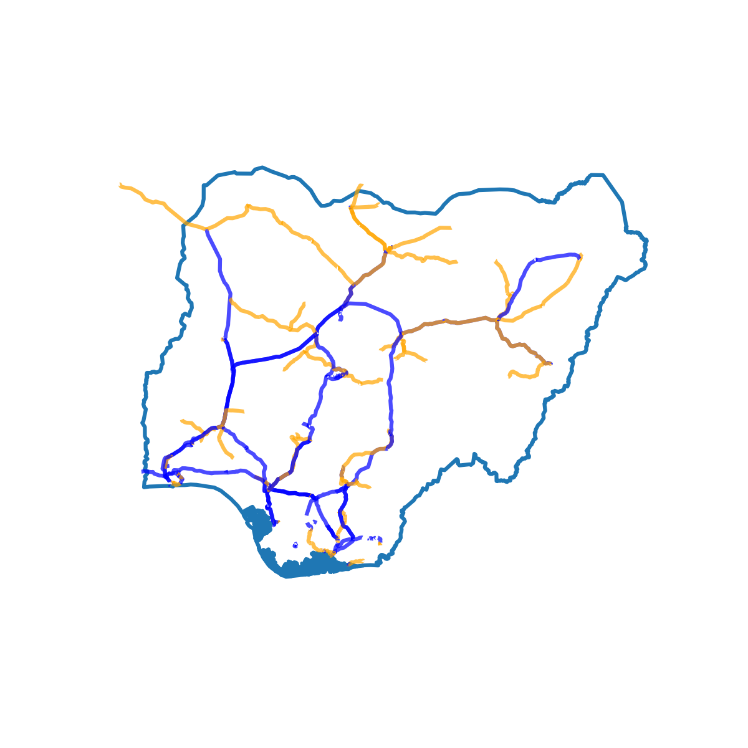
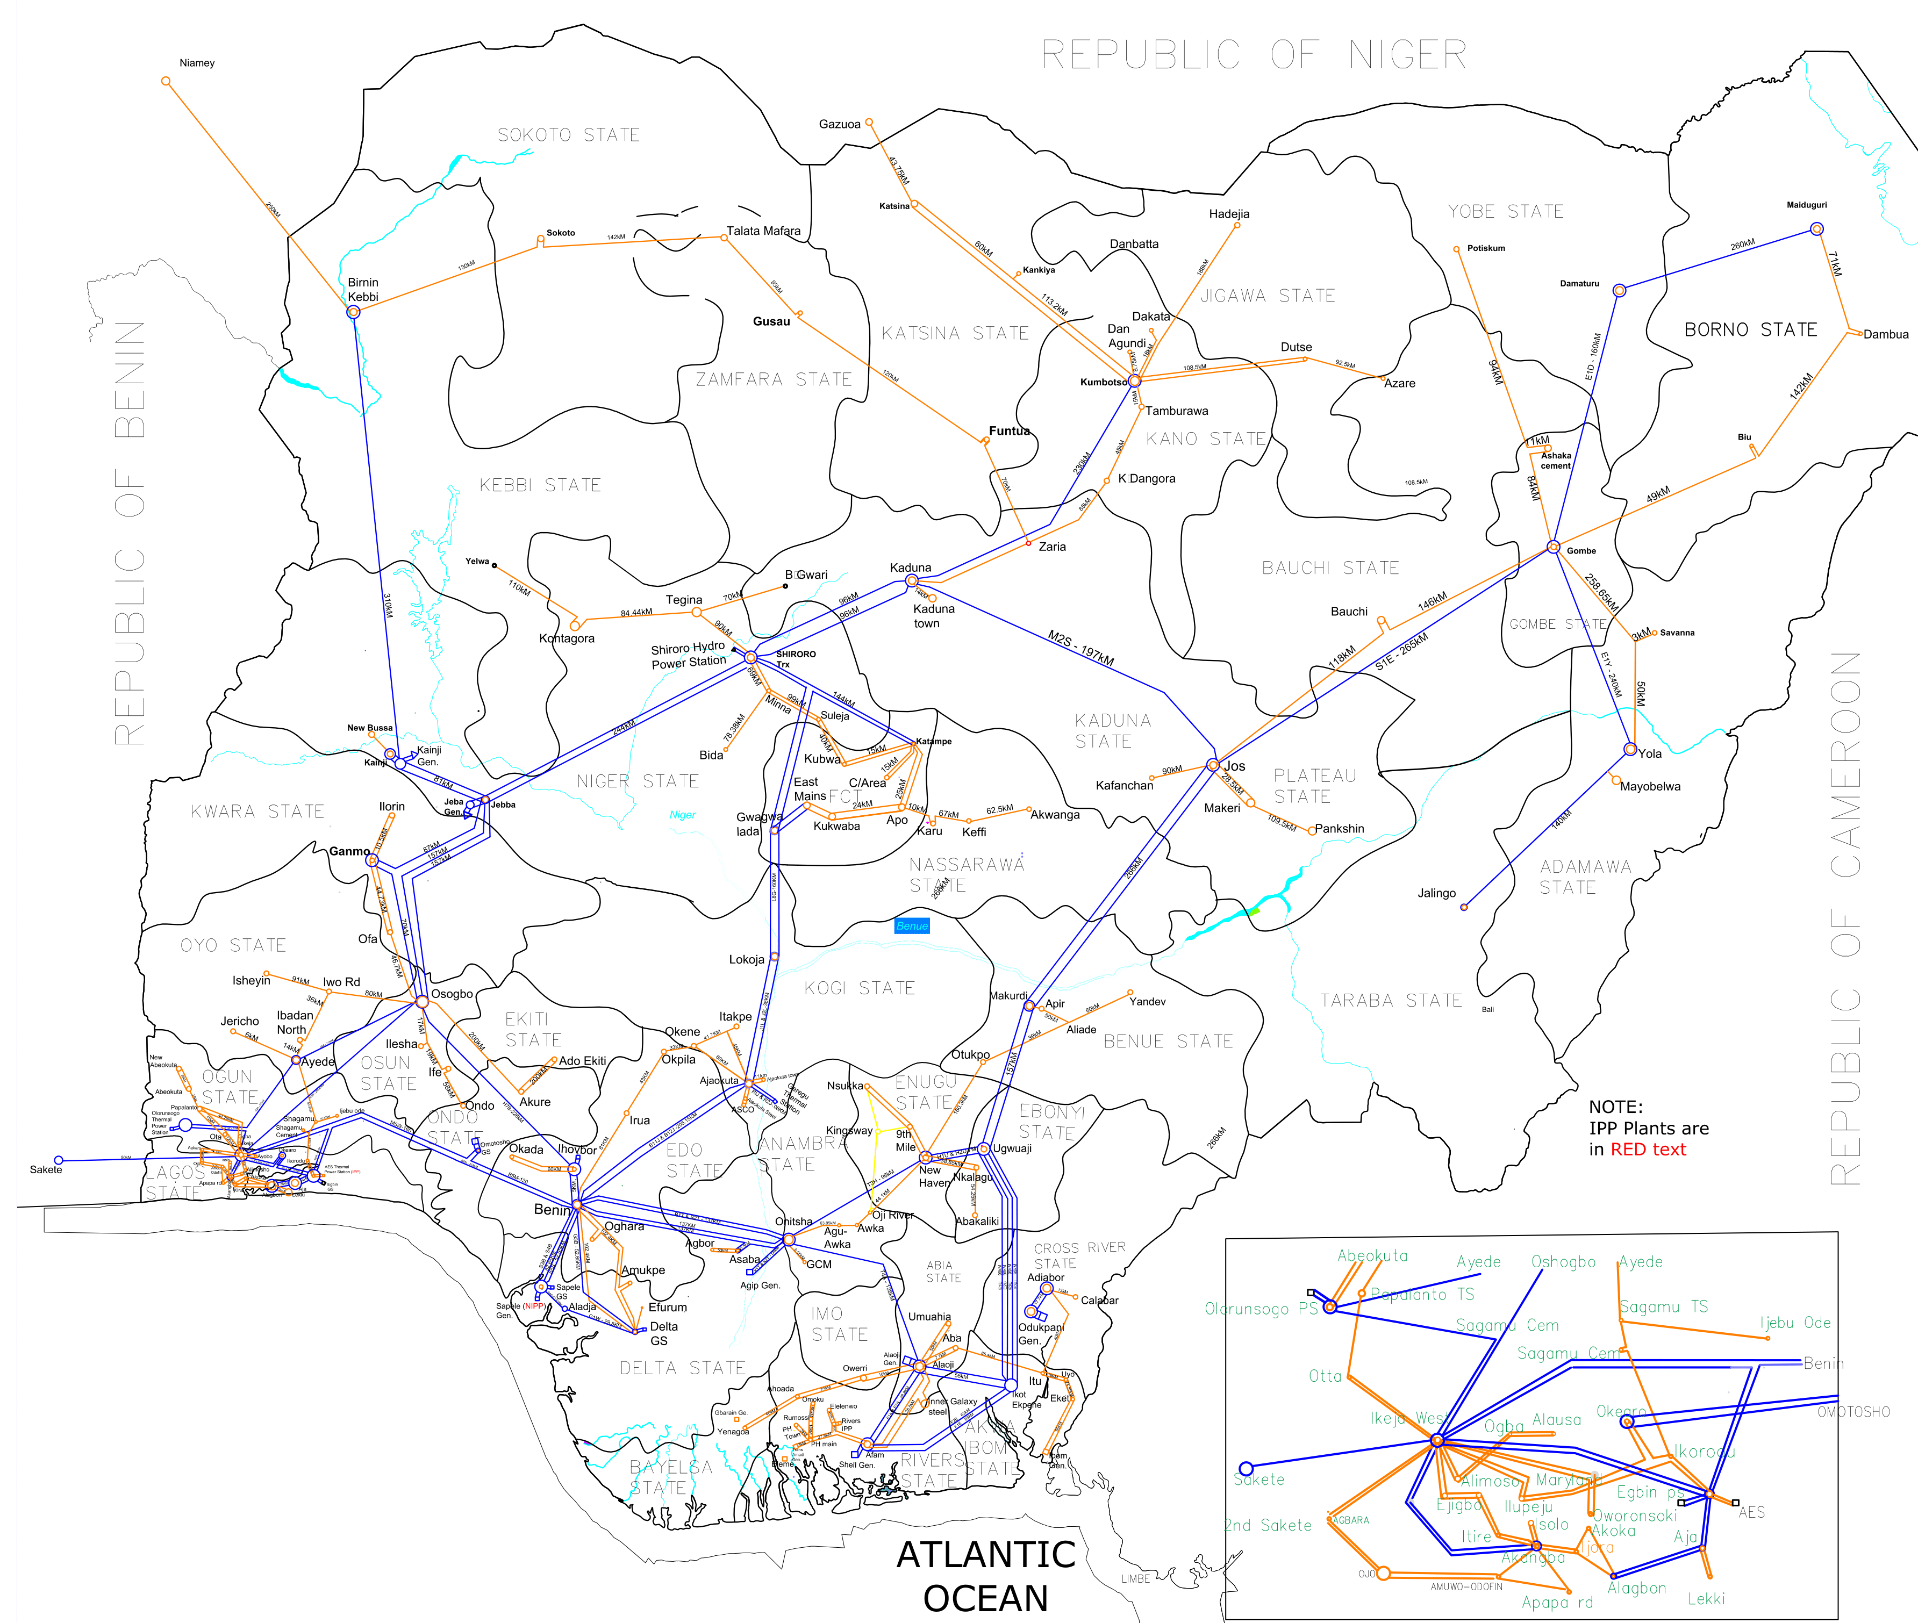
NETWORK DATA Openstreetmap
… and (group of) countries
100% validation of topology, data TSO
countries: ["NG"]
TCN Nigeria - https://www.tcn.org.ng/

Slide 19
Powerplants
WHAT DATASET?
Carbon Monitoring for Action (CARMA)
Global Energy Observatory (GEO)
Global Power Plant Database (GPD)
OpenStreetMap (OSM)
…

Slide 20
Powerplants
WHAT DATASET?
Carbon Monitoring for Action (CARMA)
Global Energy Observatory (GEO)
Global Power Plant Database (GPD)
OpenStreetMap (OSM)
…
ALL! Powerplantmatching!

Slide 21
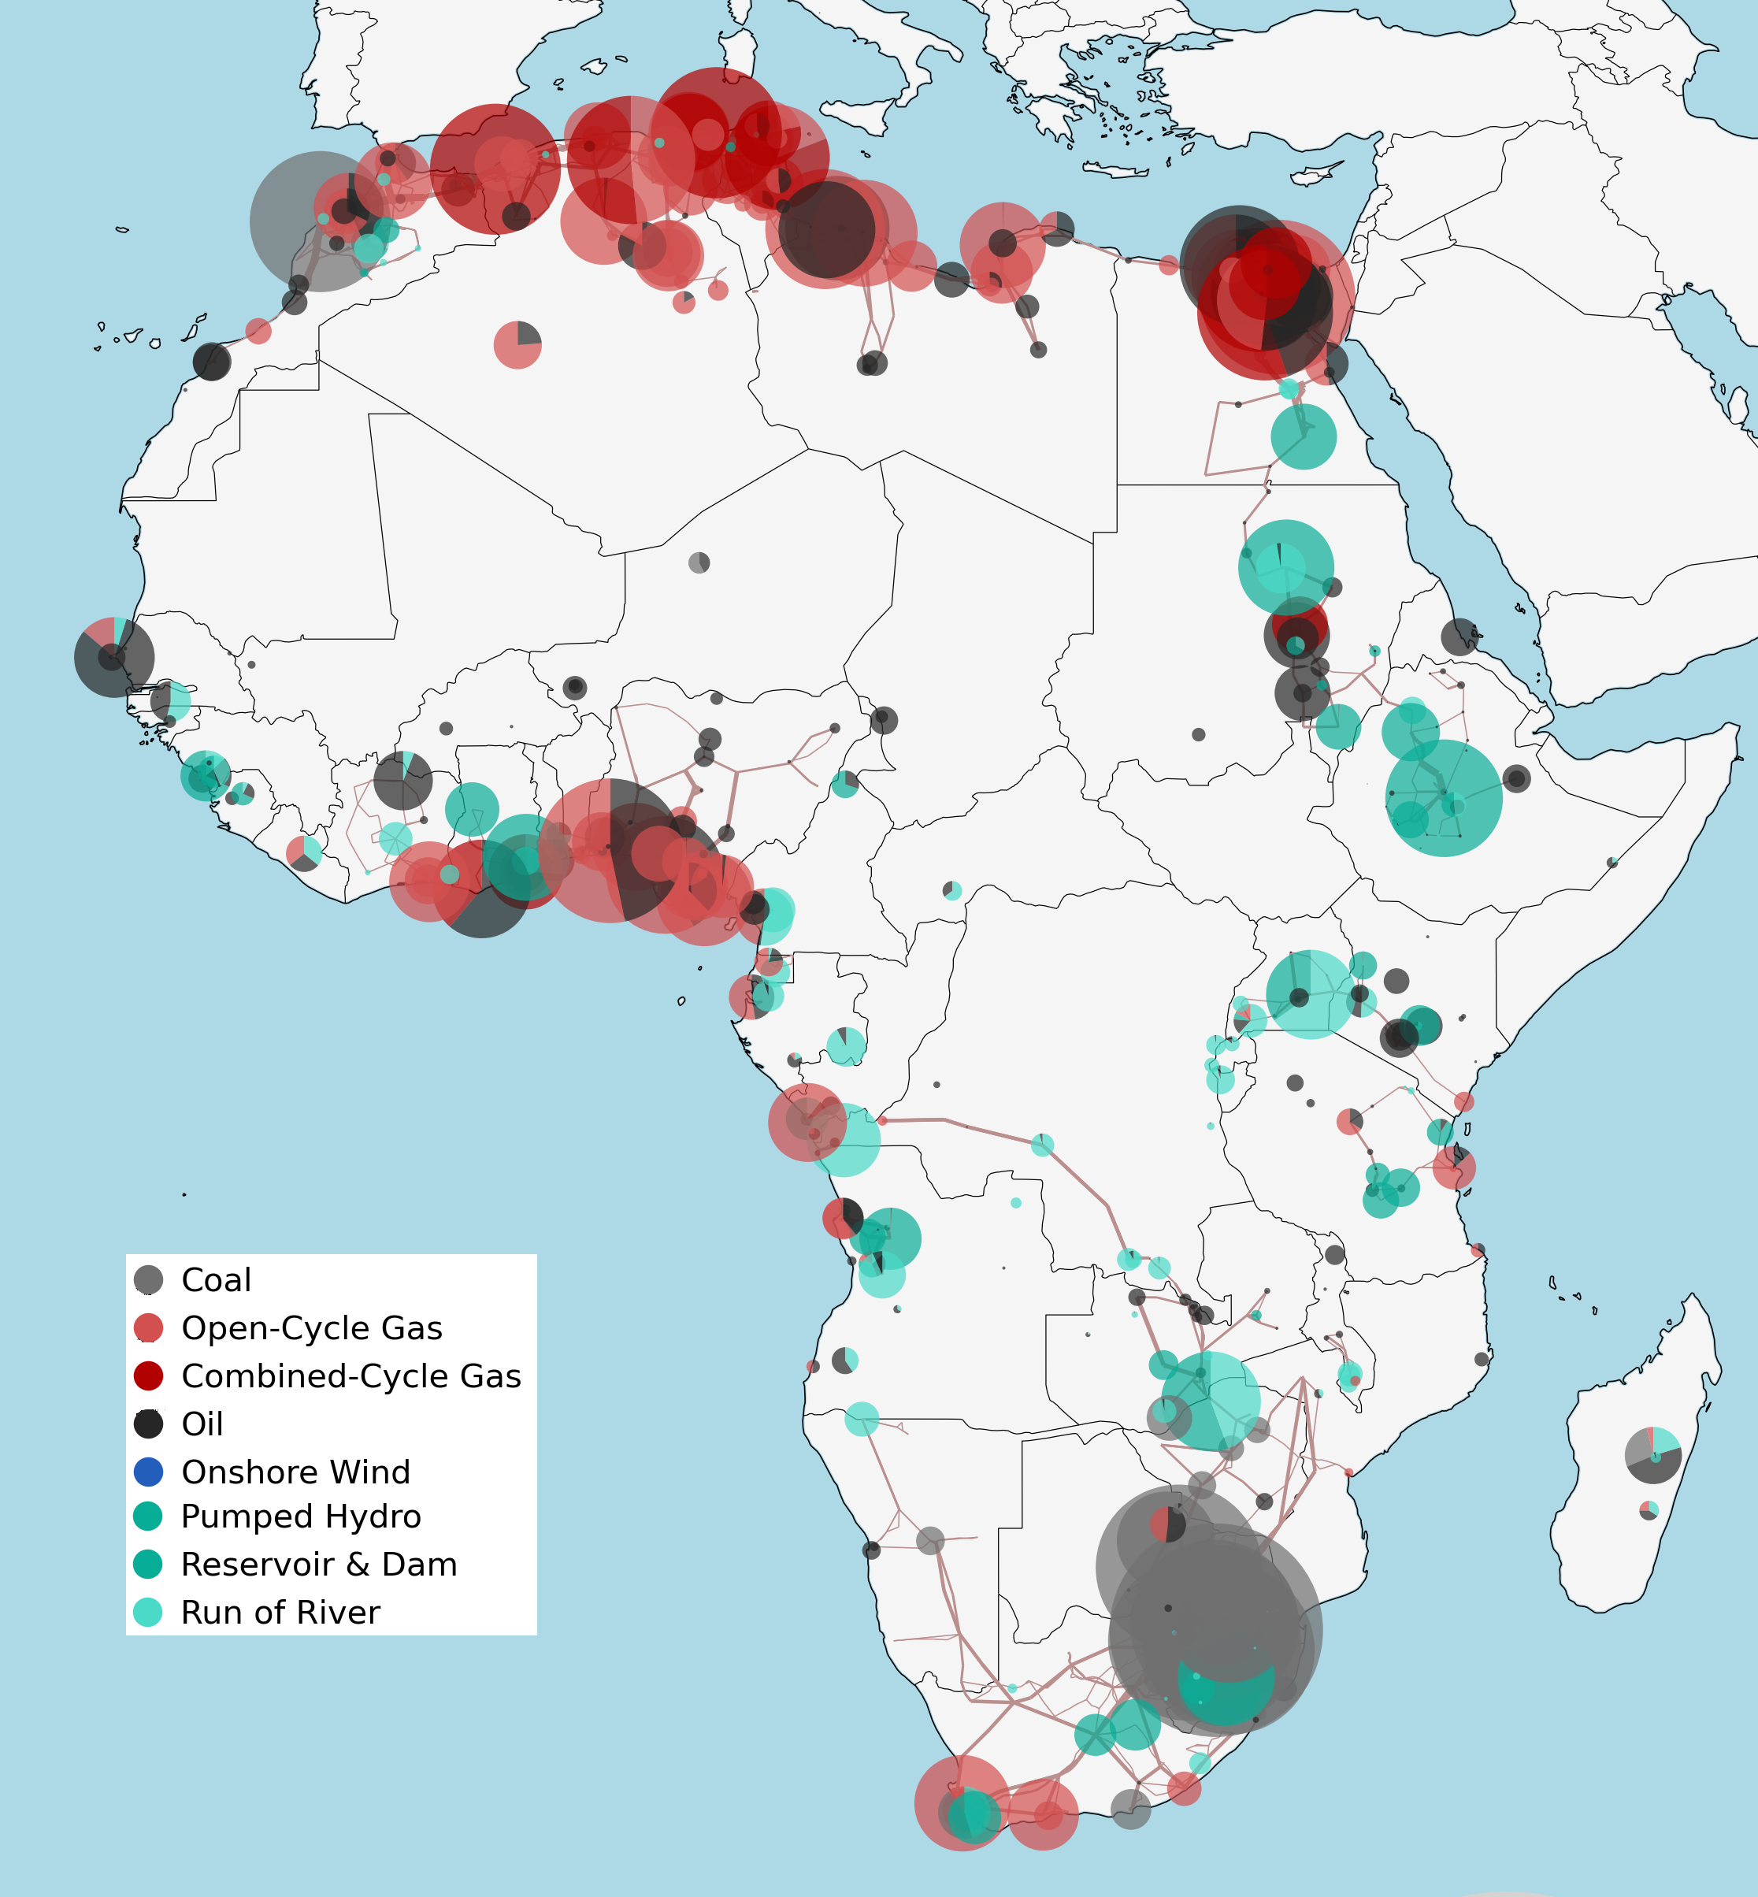
Powerplants
Datasets to merge:
Carbon Monitoring for Action (CARMA)
Global Energy Observatory (GEO)
Global Power Plant Database (GPD)
OpenStreetMap (OSM)
…yours?
Merge datasets by Powerplantmatching
F. Gotzens, H. Heinrichs, J. Hörsch, and F. Hofmann, Performing energy modelling exercises in a transparent way - The issue of data quality in power plant databases, Energy Strategy Reviews, vol. 23, pp. 1–12, Jan. 2019

Slide 22
Powerplants
Datasets to merge:
Carbon Monitoring for Action (CARMA)
Global Energy Observatory (GEO)
Global Power Plant Database (GPD)
OpenStreetMap (OSM)
…yours?
Merge datasets by Powerplantmatching
Help welcome on
Country-level validation
Merge different datasources (powerplantmatching)
Look for accurate data
F. Gotzens, H. Heinrichs, J. Hörsch, and F. Hofmann, Performing energy modelling exercises in a transparent way - The issue of data quality in power plant databases, Energy Strategy Reviews, vol. 23, pp. 1–12, Jan. 2019
https://www.irena.org/-/media/Files/IRENA/Agency/Publication/2021/March/Renewable_Energy_Transition_Africa_2021.pdf
https://iea.blob.core.windows.net/assets/2f7b6170-d616-4dd7-a7ca-a65a3a332fc1/Africa_Energy_Outlook_2019.pdf
Notes:
144 GW matched w.r.t. 210-240GW

Slide 23
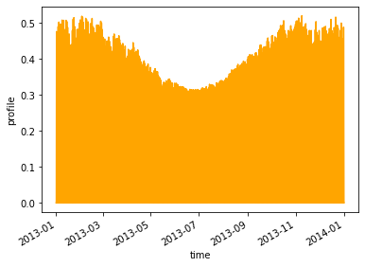
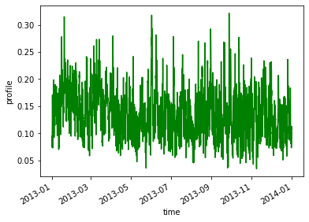
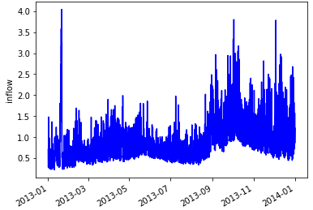
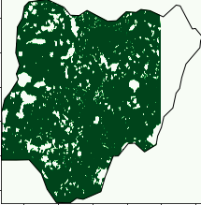
Renewable production
Solar
Resource potential
Wind
Land constraints
Hydro
CSP (coming),…
Pictures by Johannes Hampp

Slide 24
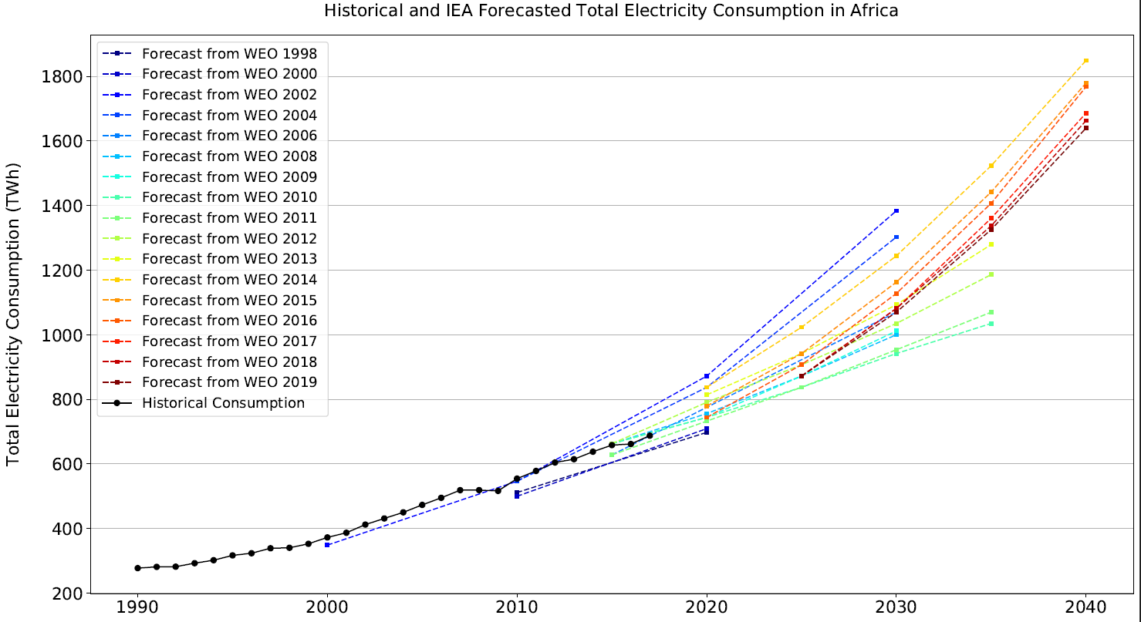
Demand data
Forecasting is not easy!
Lee, S.J. et al., How probabilistic electricity demand forecasts can expedite universal access to clean and reliable electricity. 2021. Energy for Economic Growth

Slide 25
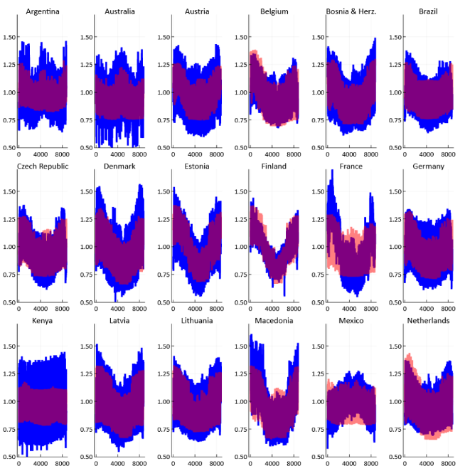
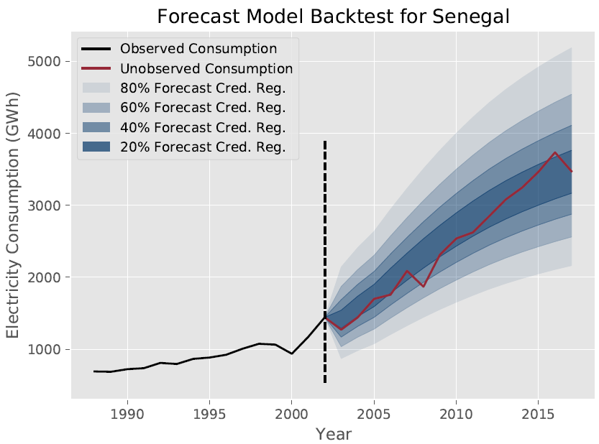
Demand data
Forecasting is not easy!
Use different models!
1) GlobalEnergyGIS* (currently used)
2) Demand-Creator (coming)
Lee, S.J. et al., How probabilistic electricity demand forecasts can expedite universal access to clean and reliable electricity. 2021. Energy for Economic Growth

Slide 26
Demand data
Forecasting is not easy!
Use different models!
1) GlobalEnergyGIS* (currently used)
2) Demand-Creator (coming)
3) Your model!
Lee, S.J. et al., How probabilistic electricity demand forecasts can expedite universal access to clean and reliable electricity. 2021. Energy for Economic Growth

Slide 27
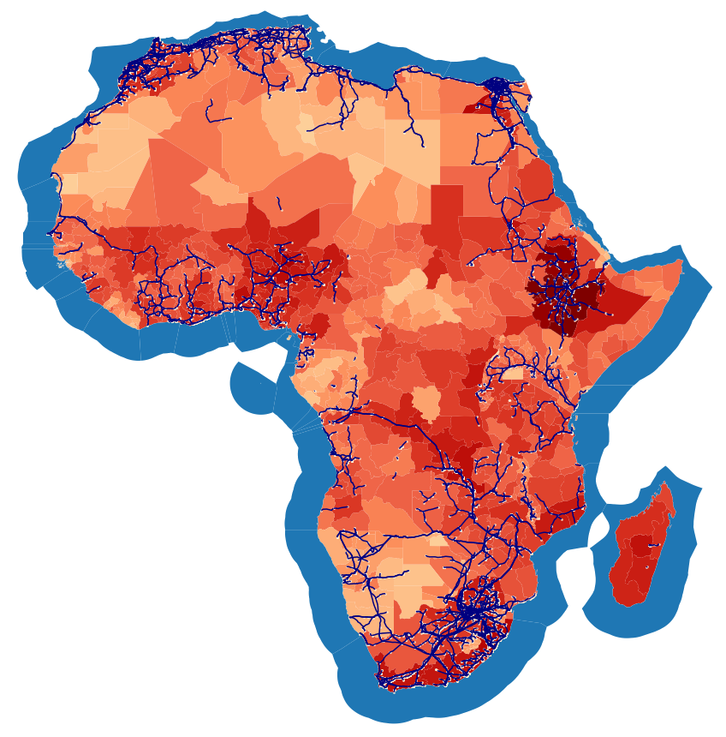
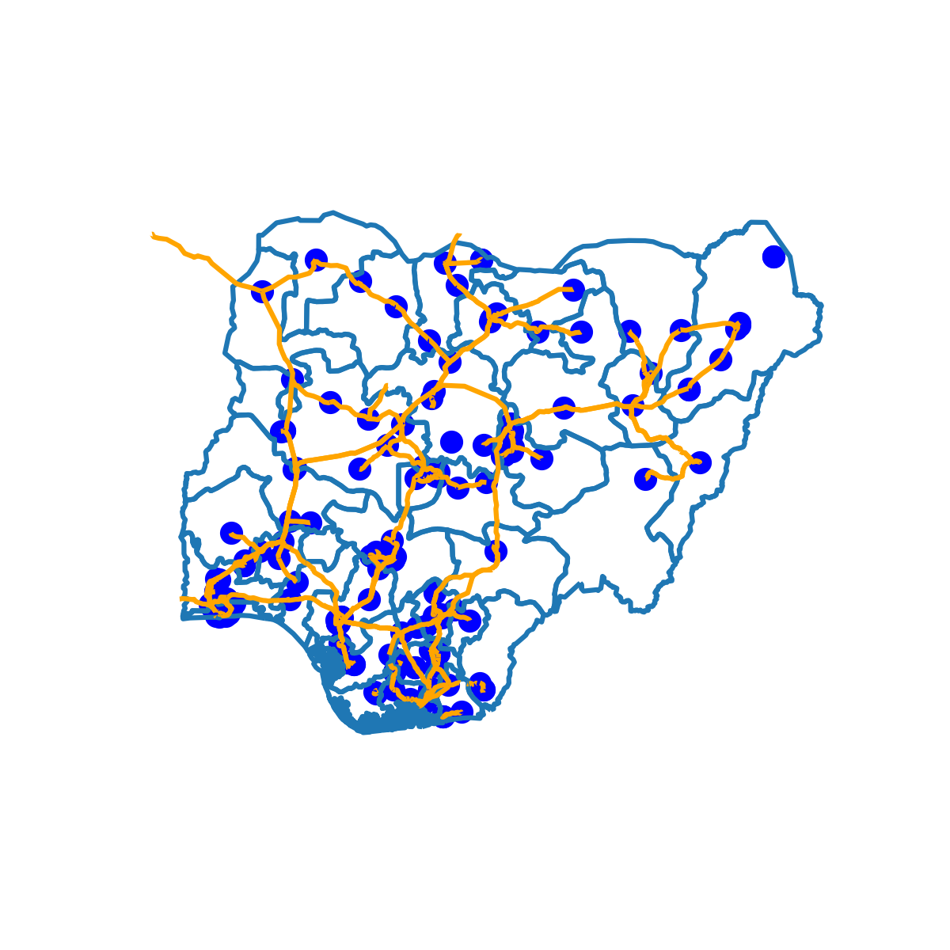
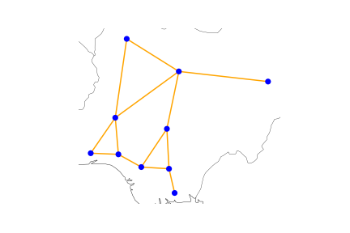
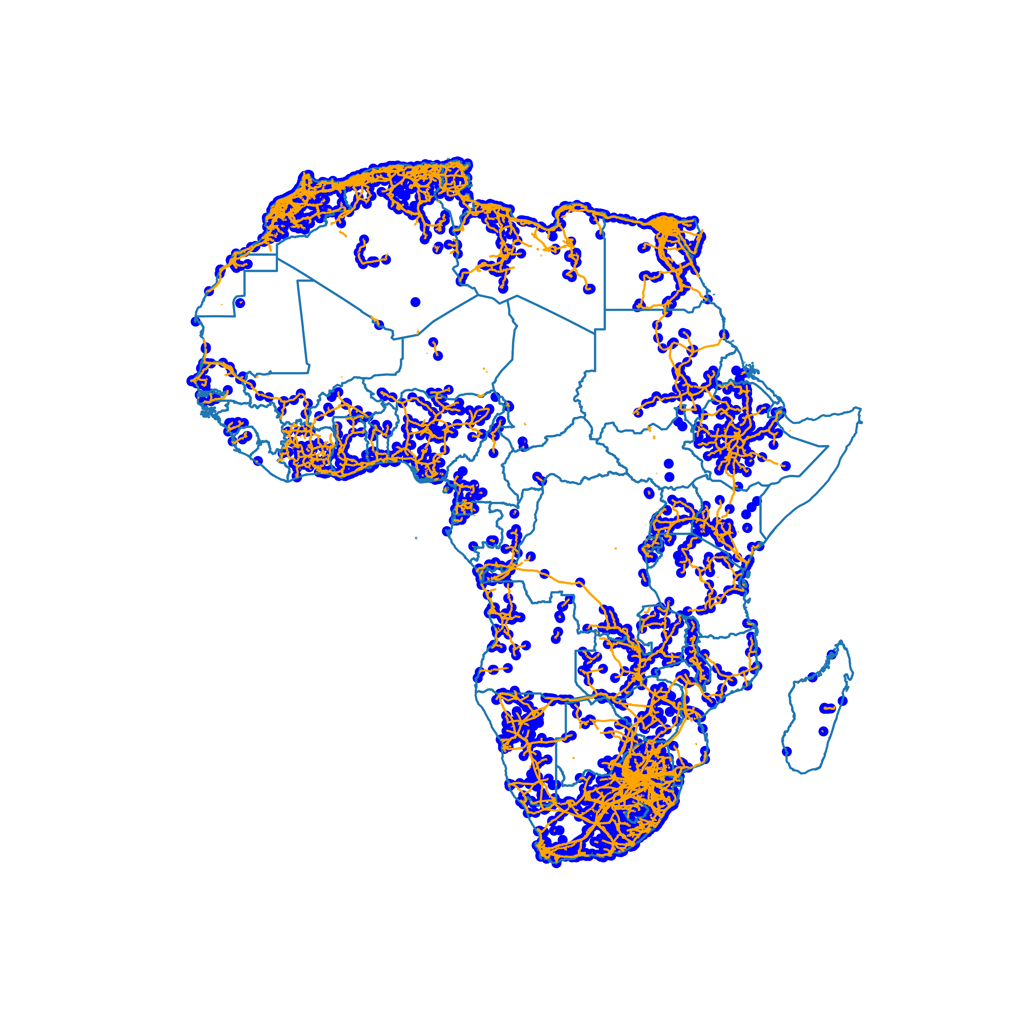
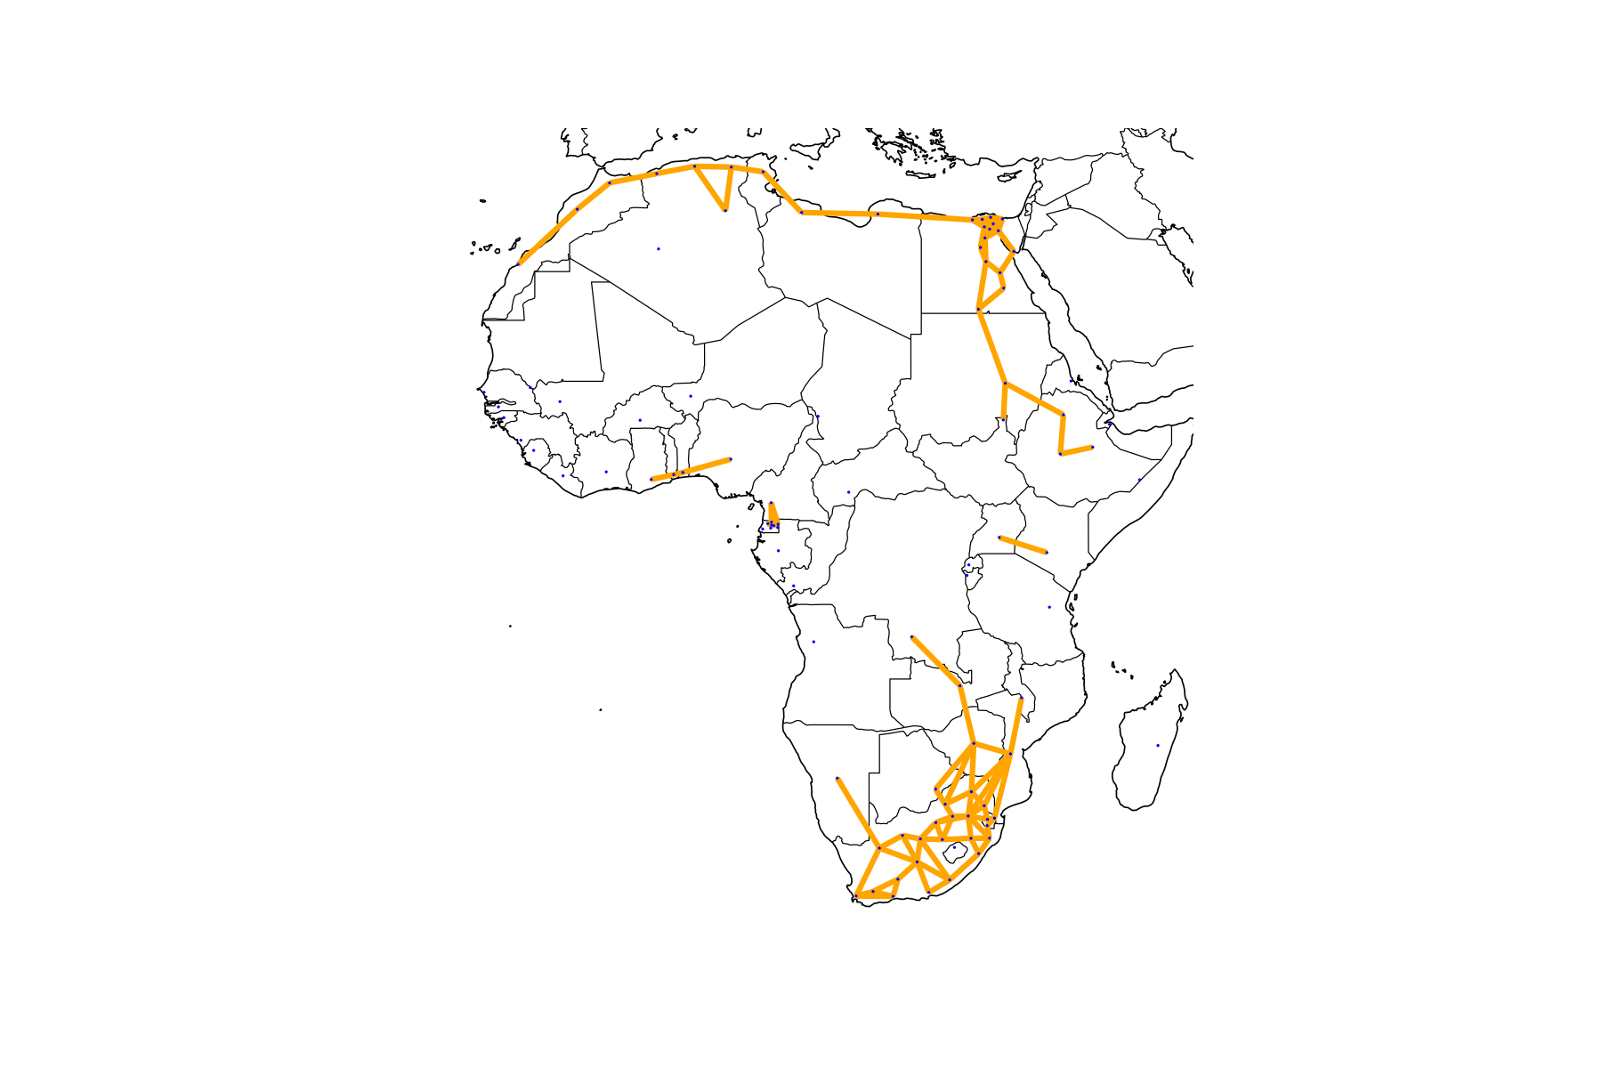
Clustering for tractability
Cleaned Network
After clustering
["Africa"]
["Nigeria"]
["Africa"]
["Nigeria"]
420-node grid, distr. param. : "load"
10-node grid
Reduction of complexity
Preserve representation of the system

Slide 28
Network augmentation
Post augmentation
Clustered network
Enhanced connections
Connection of
off-grid areas

Slide 29
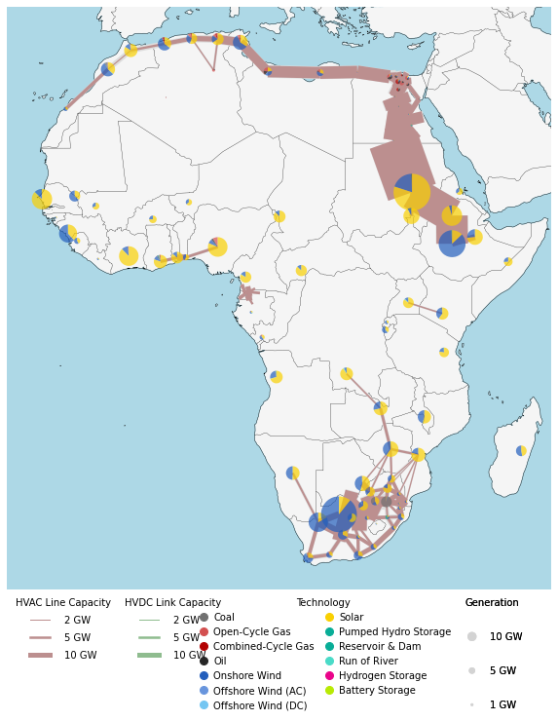
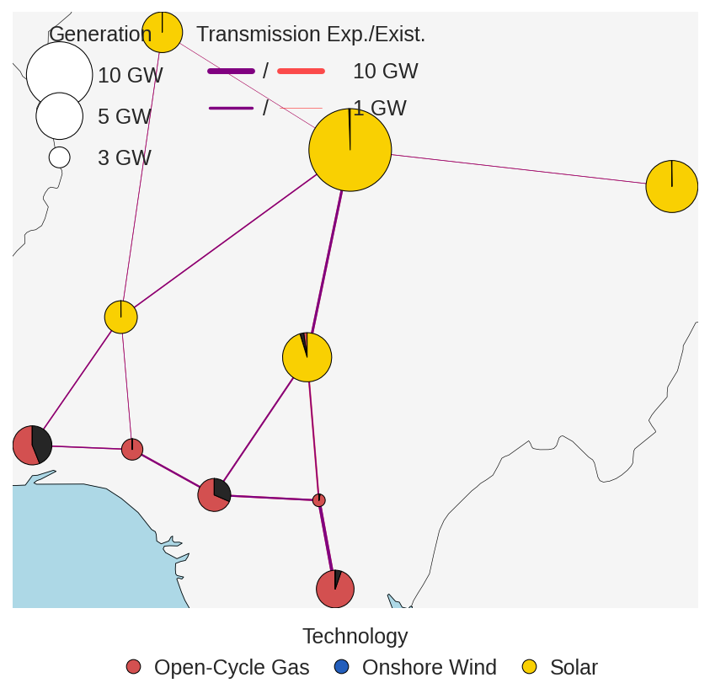
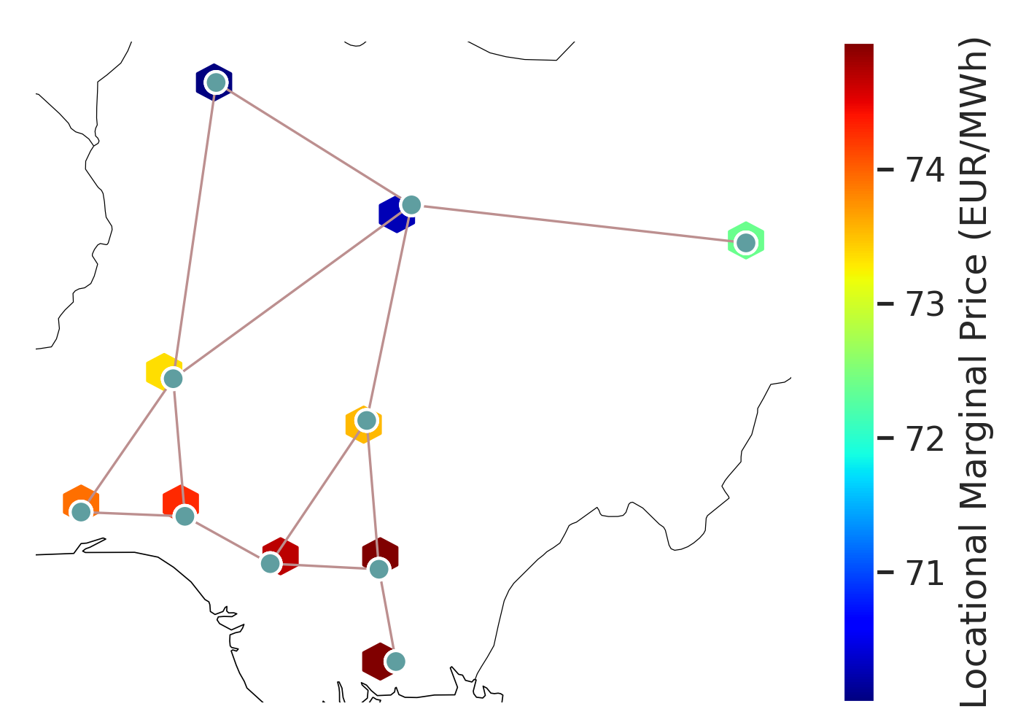
Design&Dispatch optimization
Africa
Nigeria
Willing to help?
More plots
More validation
Create scenarios
…

Slide 30
WHAT NEXT
Low data accuracy?
Only electricity?
Single-year?

Slide 31
WHAT NEXT
Ongoing validation!
«Linkers» to use most reliable source
Low data accuracy?
Only electricity?
Single-year?

Slide 32
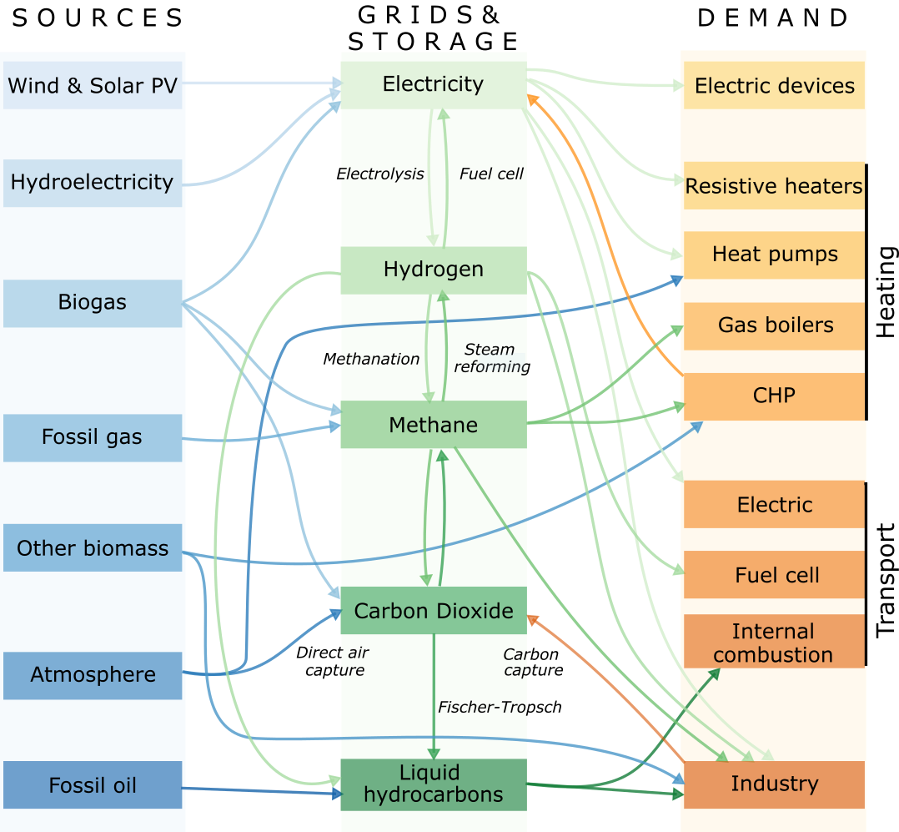
WHAT NEXT
Ongoing validation!
«Linkers» to use most reliable source
Low data accuracy?
Only electricity?
PyPSA Africa Sector coupled!
@PyPSA-Eur-Sec
Single-year?

Slide 33
WHAT NEXT
Ongoing validation!
«Linkers» to use most reliable source
Low data accuracy?
Only electricity?
PyPSA Africa Sector coupled!
@PyPSA-Eur-Sec
Single-year?
Pathway optimization!
today
2030
2040
2050
…

Slide 34
GETTING READY to CHANGe THE WORLD
PyPSA meets Earth
2022​ ​

Slide 35
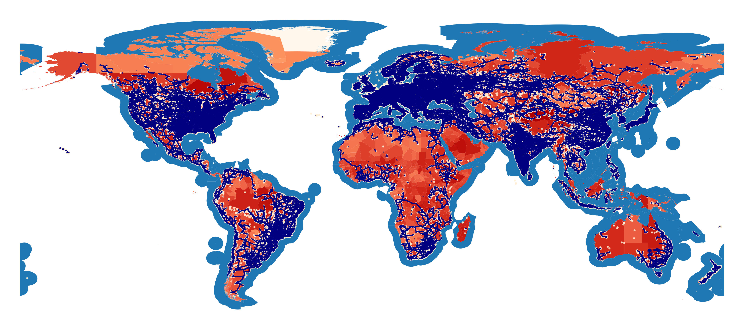

Slide 36
PyPSA-Africa and PyPSA-Earth welcome support for:
Electrical and energy engineers, computer science, data scientists, GIS experts and Python developers.
High-level insights from NGOs, governmental entities and project developers.
Contributors to validate country data
Institutions and companies for data access and resources to speed up the development.
Providers of cloud and remote computing resources.

Slide 37
1.
THE PYPSA MEETS EARTH INITIATIVE
III.
DEALING WITH MISSING DATA
II.
THE PYPSA-AFRICA PROTOTYPE PRESENTATION

Slide 38
I.
INFRASTRUCTURE
DETECTION
II.
DEMAND PREDICTION

Slide 39
Previous Work
World Bank & Development Seed
http://devseed.com/ml-griddocs/introduction/strategy/

Slide 40
Previous Work
World Bank & Development Seed
http://devseed.com/ml-griddocs/introduction/strategy/

Slide 41
Previous Work
World Bank & Development Seed
http://devseed.com/ml-griddocs/introduction/strategy/

Slide 42
Previous Work
World Bank & Development Seed
http://devseed.com/ml-griddocs/introduction/strategy/

Slide 43
Previous Work
World Bank & Development Seed
World Bank & Facebook
http://devseed.com/ml-griddocs/introduction/strategy/
nara.getarchive.net

Slide 44
Previous Work
World Bank & Development Seed
World Bank & Facebook
http://devseed.com/ml-griddocs/introduction/strategy/
gridfinder.org

Slide 45
Re-Tackle Detection of Individual Towers
Three Develop ments
https://figshare.com/articles/dataset/Electric_Transmission_and_Distribution_Infrastructure_magery_Dataset

Slide 46
Re-Tackle Detection of Individual Towers
Grid Infrastructure Dataset by
Duke University
Three Develop ments
https://figshare.com/articles/dataset/Electric_Transmission_and_Distribution_Infrastructure_Imagery_Dataset

Slide 47
Re-Tackle Detection of Individual Towers
Grid Infrastructure Dataset by
Duke University
Three Develop ments
Satellite Imagery released by maxar for
humanitarian purposes
maxar.com/open-data
https://figshare.com/articles/dataset/Electric_Transmission_and_Distribution_Infrastructure_Imagery_Dataset

Slide 48
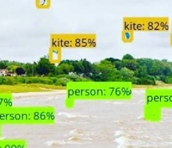
Re-Tackle Detection of Individual Towers
Grid Infrastructure Dataset by
Duke University
Three Develop ments
Satellite Imagery released by maxar for
humanitarian purposes
Research advances in machine learning
transfer
train
infer
maxar.com/open-data
https://figshare.com/articles/dataset/Electric_Transmission_and_Distribution_Infrastructure_Imagery_Dataset
https://pxhere.com/en/photo/560374

Slide 49
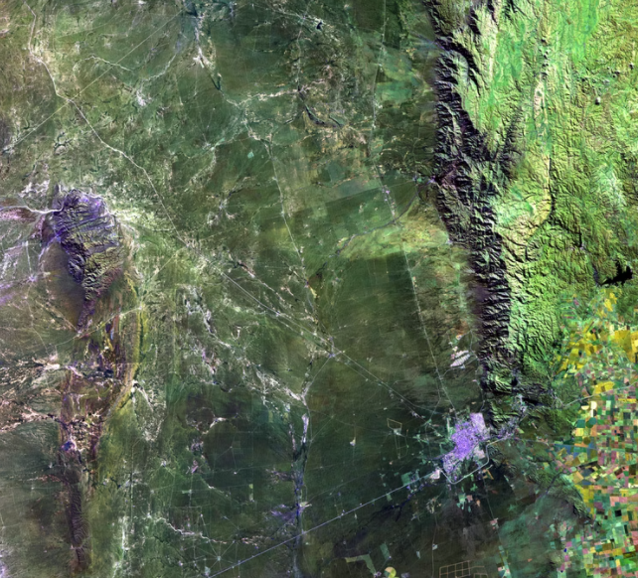
Re-Tackle Detection of Individual Towers
Grid Infrastructure Dataset by
Duke University
Three Develop ments
Satellite Imagery released by maxar for
humanitarian purposes
Research advances in machine learning
gridfinder.org

Slide 50
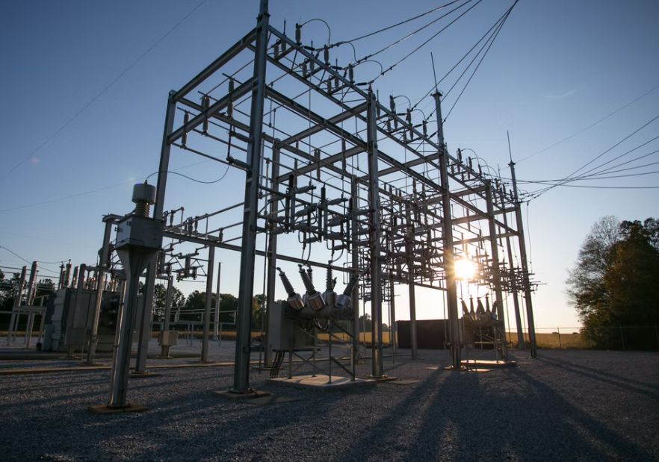
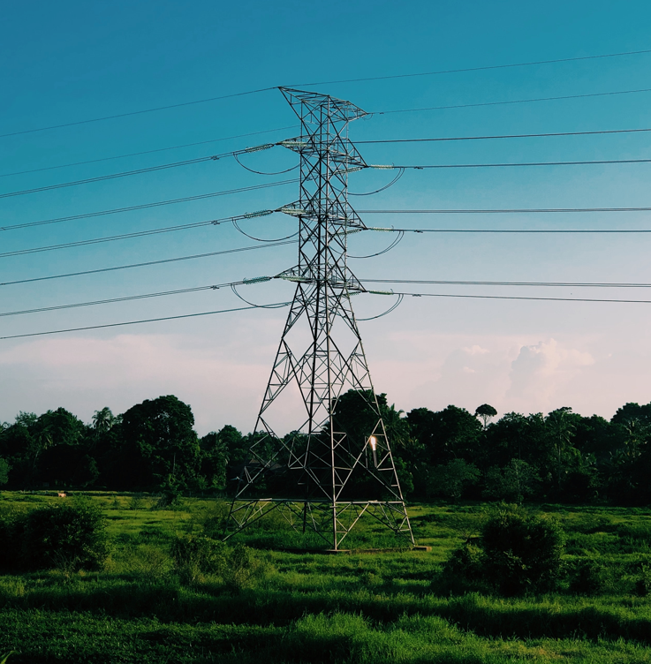
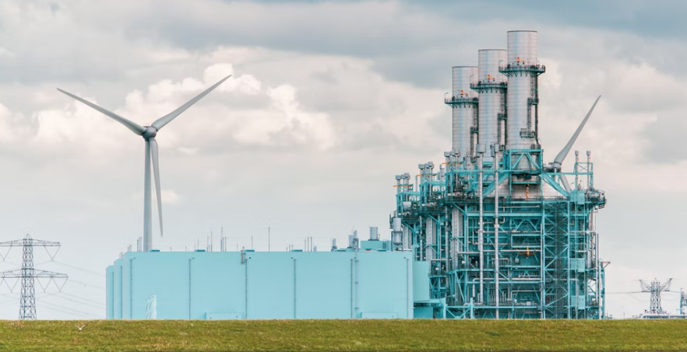
Re-Tackle Detection of Individual Towers
The PyPSA meets Africa detect-energy team welcomes support:
Machine learning engineers, data scientists and Python developers.
Cloud credits for computation and data storage.
High-level insights from NGOs, governmental entities and project developers.
unsplash.com

Slide 51
I.
INFRASTRUCTURE
DETECTION
II.
DEMAND PREDICTION

Slide 52
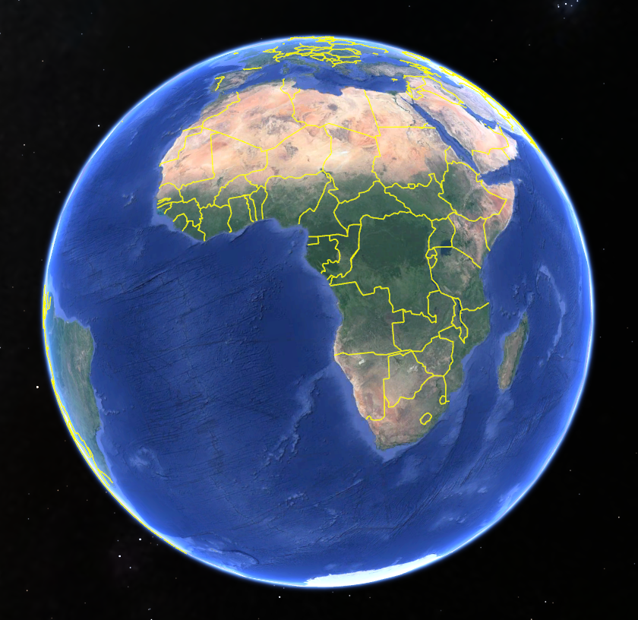
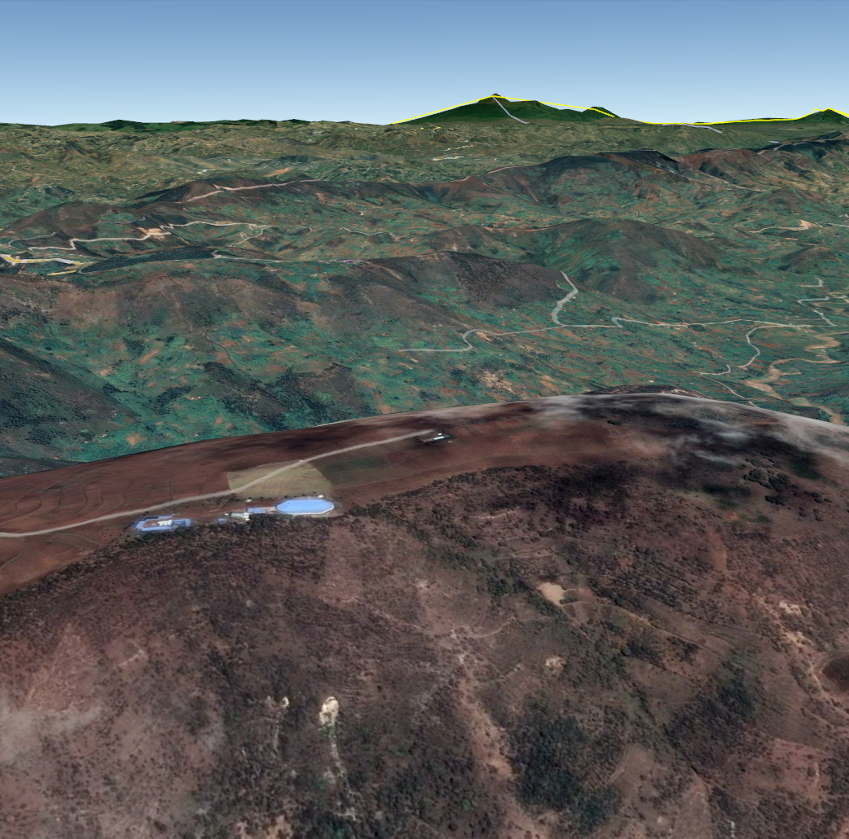
Machine Learning-Based Demand Forecasting Across Africa
1. Country-Level Demand Forecasting
PyPSA meets Africa
2. Data-driven Downscaling
Aggregation
(optional)
3. Building-Level Demand Forecasting
Notes:
My name is Stpehen Lee I am a PhD candidate at MIT and Demand Lead with the PyPSA community.
Electricity demand foreacsing in Africa is my thesis topic. I’m going to be open sourcing all of my published research code as part of PyPSA and in the meantime make data pipelines open and work with others to come up with different methods for baselining and comparison.
Data is available at multiple scales: 3 part pipeline taking advantage of all scales.
Multimodal and multiscale data fusion.
Need help on all 3 parts.

Slide 53
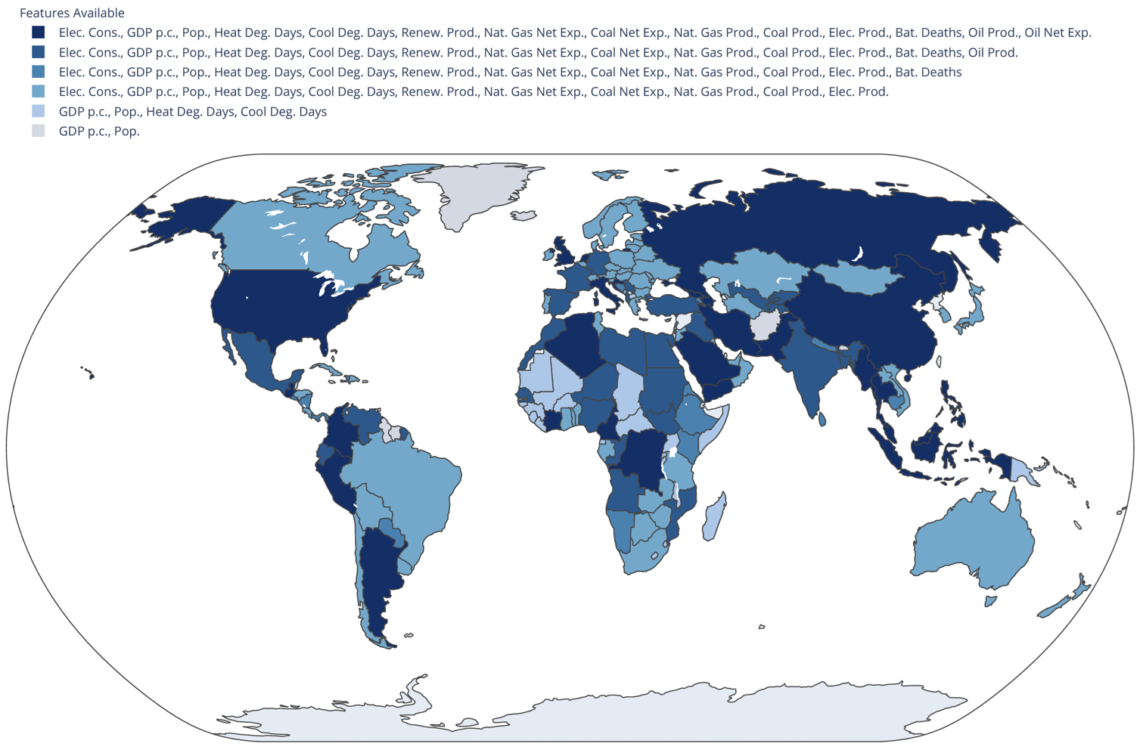
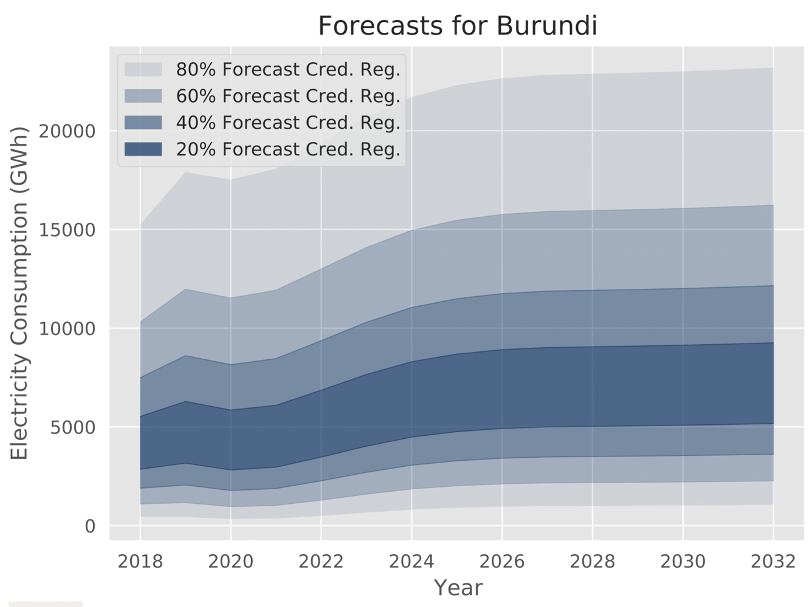
Country-Level Demand Forecasting
via Bayesian Deep Learning and Others
Sources: S. J. Lee, D. Suri, P. Somani, C. L. Dean, J. Pacheco, R. Stoner, I. Perez-Arriaga, J. W. Fisher III, and J. Taneja, “How probabilistic electricity demand forecasts can expedite universal access to clean and reliable electricity,” Energy for Economic Growth, 2021.; S. J. Lee, C. L. Dean, D. Suri, P. Somani, J. Pacheco, R. Stoner, I. Perez-Arriaga, J. W. Fisher III, and J. Taneja, “Probabilistic forecasts of country-level electricity demand in Africa,” 2022 (not yet public). – Soon to be open-sourced, please contact authors
Notes:
Rigorous backtesting frameworks
Hosting a competition for the best ML models with the backtesting framework
High-quality consumption metrics
Some missing data
Probabilistic representations via Bayesian deep learning

Slide 54
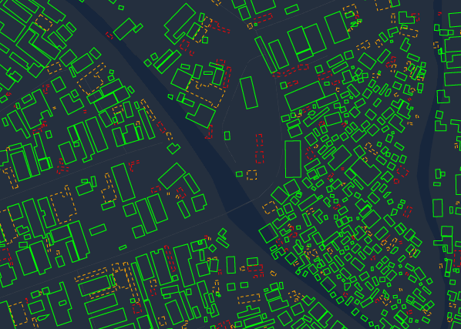
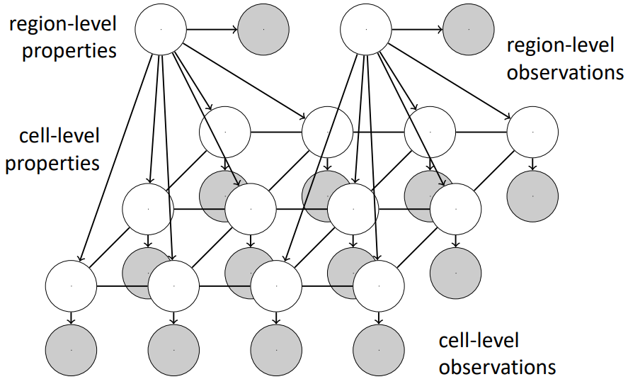
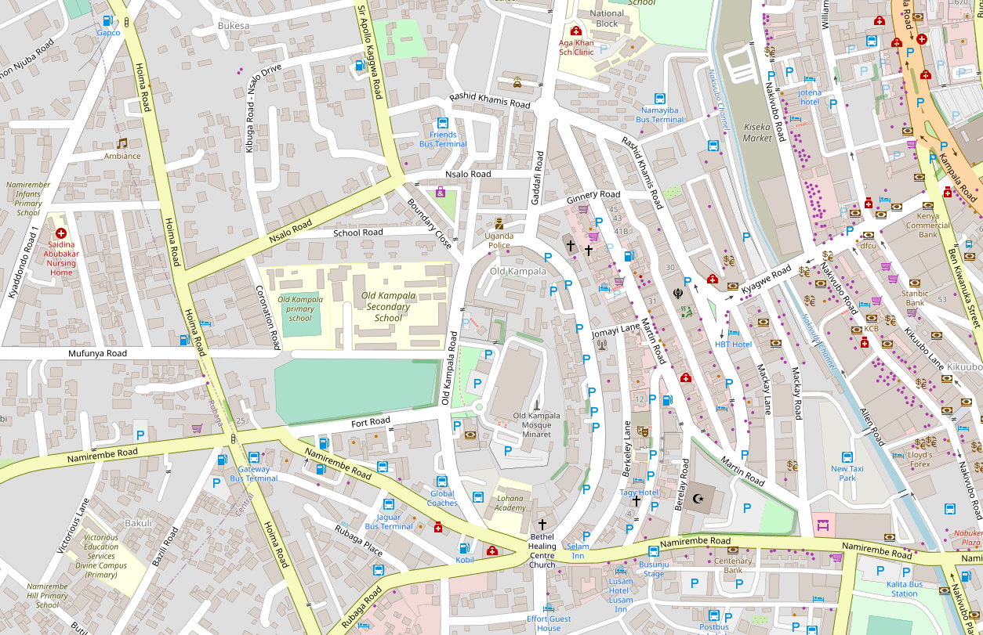
2. Downscaling via Economics-Informed Probabilistic Models and Others
W. Sirko, S. Kashubin, M. Ritter, A. Annkah, Y.S.E. Bouchareb, Y. Dauphin, D. Keysers, M. Neumann, M. Cisse, J.A. Quinn. Continental-scale building detection from high resolution satellite imagery. arXiv:2107.12283, 2021.; Haklay, M. and Weber, P., 2008. Openstreetmap: User-generated street maps. IEEE Pervasive computing, 7(4), pp.12-18.
Notes:
OSM
Google open buildings dataset
data-driven assumptions about demand distributions

Slide 55
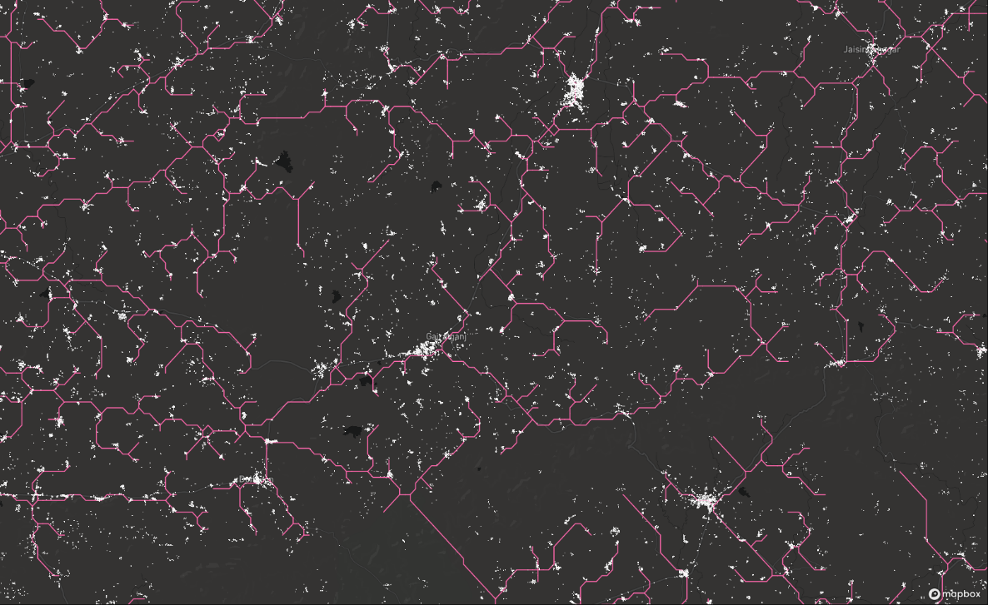
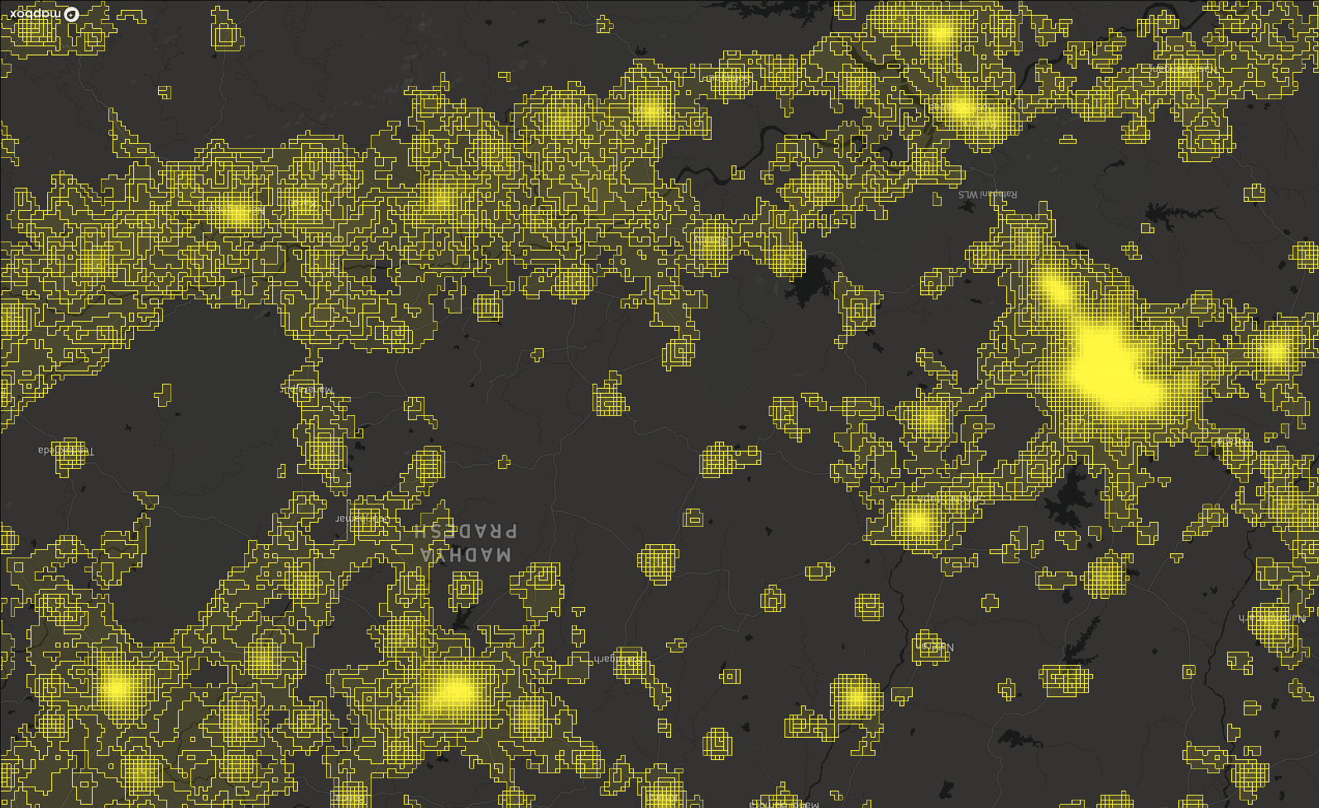
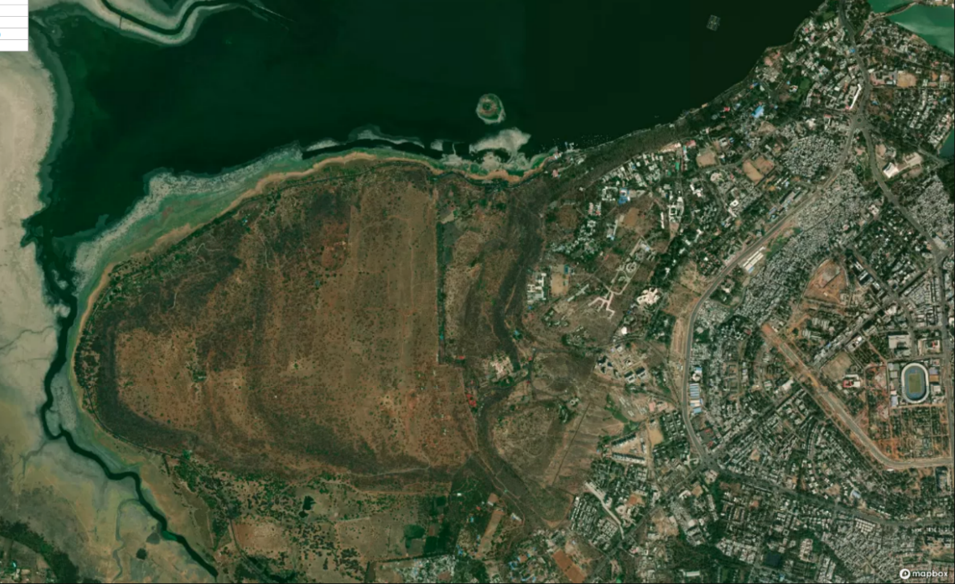
3. Building-Level Demand Forecasting
via Bayesian Deep Learning and Others
Notes:
OSM
Google open buildings dataset
data-driven assumptions about demand distributions

Slide 56
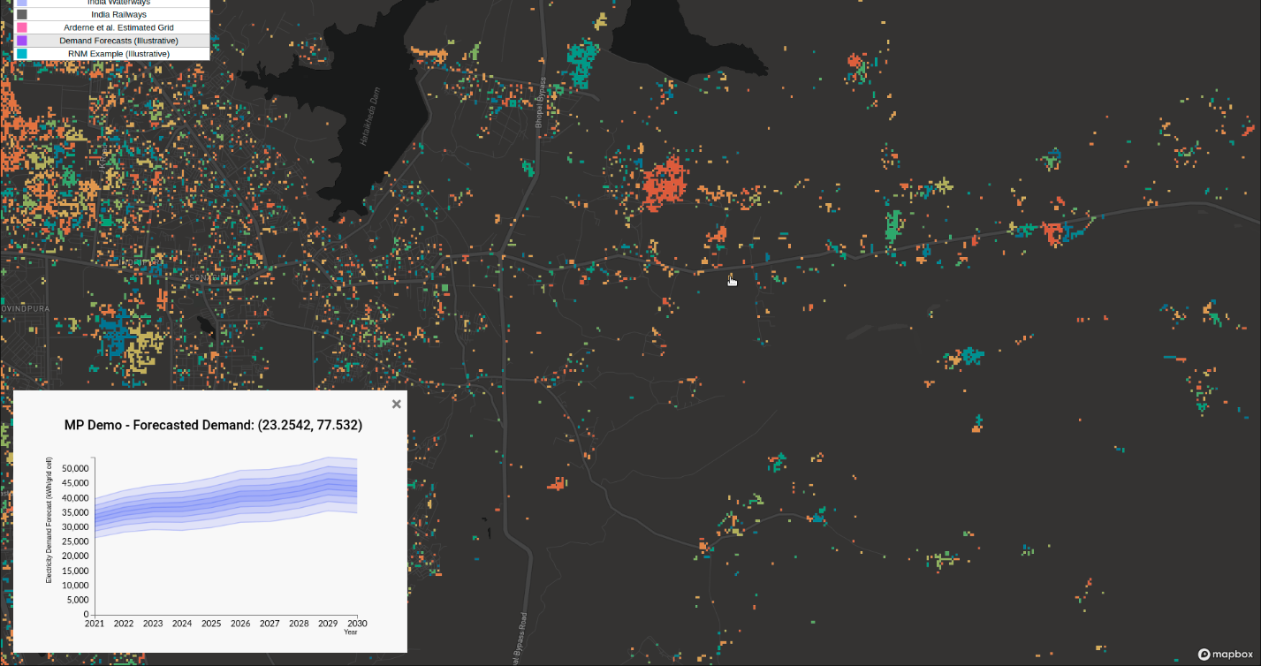
3. Building-Level Demand Forecasting
via Bayesian Deep Learning and Others
Illustrative output
Notes:
OSM
Google open buildings dataset
data-driven assumptions about demand distributions

Slide 57
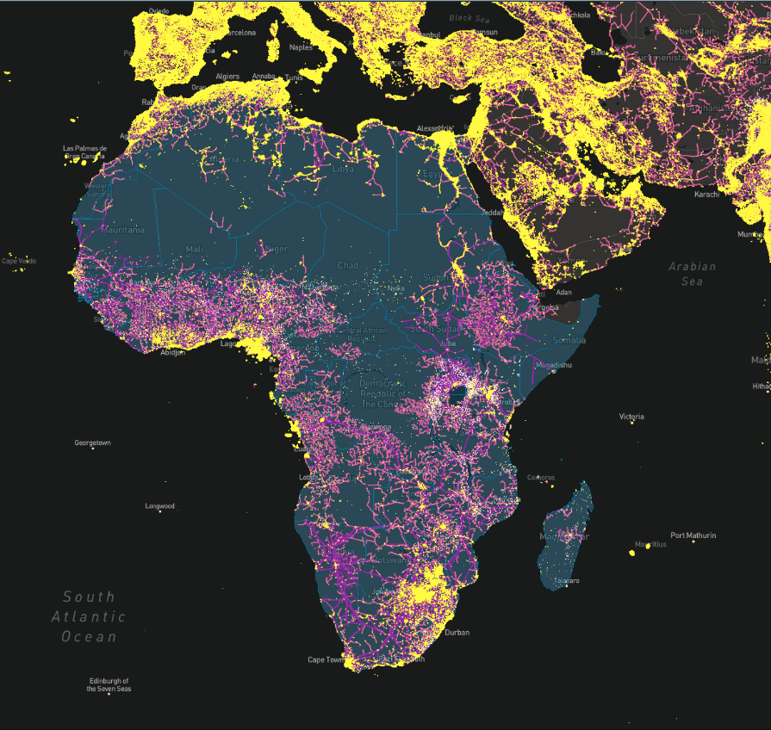
Machine Learning-Based Demand Forecasting Across Africa
What the PyPSA meets Africa demand team is looking for:
GIS analysts, data scientists, machine learning engineers and researchers, frontend developers, backend developers.
African agricultural experts, energy policy analysts, climate change analysts.
Cloud credits for hosting tile servers.
Collaborations with African governments, utilities, NGOs, and project developers for:
Ground-truth validation of results
Open-sourcing anonymized consumption data
Other beneficial uses of electricity demand forecasts.
Notes:
My name is Stpehen Lee I am a PhD candidate at MIT and Demand Lead with the PyPSA community.
Electricity demand foreacsing in Africa is my thesis topic. I’m going to be open sourcing all of my published research code as part of PyPSA and in the meantime make data pipelines open and work with others to come up with different methods for baselining and comparison.
Data is available at multiple scales: 3 part pipeline taking advantage of all scales.
Multimodal and multiscale data fusion.
Need help on all 3 parts.

Slide 58
1.
THE PYPSA MEETS EARTH INITIATIVE
III.
DEALING WITH MISSING DATA
II.
THE PYPSA-AFRICA PROTOTYPE PRESENTATION
IV.
HOW TO GET INVOLVED IN OUR EARTH-MISSION

Slide 59
Join our Team!
Our intiative has 61 members...
26 coders
27 advisors
9 communicators
14 PhD students
9 professors
13 energy professionals
...students, postdocs, scientists...
...associated to:

Slide 60
WHY PEOPLE JOIN US?
How PeOple join us
Creating impact
Solve your energy problem
Learn and apply methods
Work together
What is your motivation?
As a hobby
Use for your work
Fund dedicated positions (coming)

Slide 61
OUR WISHLIST
OR: WHAT WE NEED TO CONTINUE
Contribute new open data and methods
Expand and validate model in your region
Participate and share your ideas
Join or lead an open data campaign
Join or lead a code team

Slide 62
Open
Source
Ladder
LEAD
IMPROVE
PARTICIPATE
"up and down the ladder" by Robert Couse-Baker is licensed under CC BY 2.0
USE
UNDERSTAND

Slide 63
Q&A
15min
1.
THE PYPSA MEETS EARTH INITIATIVE
III.
DEALING WITH MISSING DATA
V.
PANEL DISCUSSION
"THE ENERGY SYSTEM MODELLING CHALLENGES AND OPPORTUNITIES OF THE 21 CENTURY"
II.
THE PYPSA-AFRICA PROTOTYPE PRESENTATION
Q&A
15min
IV.
HOW TO GET INVOLVED IN OUR EARTH-MISSION

Slide 65
GETTING READY to CHANGe THE WORLD
PyPSA meets Earth
2022​ ​

Slide 69
DEEP DIVE - tools in the community -
DRAFTS/BACK-UP

Slide 70
WHAT IS POSSIBLE?
POLICY RECOMMENDATIONS
ENERGY TRANSITION PLANS
GRID EXPANSION STUDIES
GENERATION EXPANSION STUDIES
TECHNOLOGY EVALUATIONS​
...
INFLUENCE DECISION MAKING - CASA INDIA

Slide 71
VISION
Create TOGETHER useful alternatives to closed-source energy system models
for industry and research
Notes:
OPEN:
- To avoid information asymetries industry and policy
TOGETHER means:
1 model to cover the world
1 modular architecture to allow parallel work and improvement
BENEFITS OF WORKING TOGETHER:
- Faster development
- Improvements have global impact
- Less documentation per person
Everyone can earn maintainership

Slide 72
MISSION
#PyPSA-AFRICA2021
#PyPSA-EARTH2022
#…?
Notes:
How can we achieve that? What are the problems

Slide 73
DEEP DIVE - tools in the community -

Slide 74
PROBLEM
FORMULATOR
DATA
WORKFLOW
DATA
CREATION
SOLVER
UX/UI
@LINOPY
@SMS++
@PIPS-IPM++
@PYPSA
@PYPSA-AFRICA
@PYPSA-EUR
@PYPSA-EUR-SEC
@ATLITE
@PYPSA-AFRICA
@ALL
@PYAM

Slide 77
PyPSA-Earth
Detect-Energy
Demand-Creator
A highly flexible sector-coupled energy system model of the global energy system
A machine learning framework to detect energy assets from satellite images
A general framework to create demand timeseries in subnational resolution

Slide 78
An open digital twin of energy systems
*that can optimize

Slide 79
EMPOWERING
PEOPLE

Slide 80
GETTING READY to CHANGe THE WORLD
PyPSA meets Earth
2022​ ​

Slide 82
DUPLICATION – REMOVAL?
1) Empowering people: growing community (>60pp)
2) Collaborative environment for answering energy questions through open tools, solvers and data
PyPSA-Africa
Detect-Energy
Demand-Creator

Slide 83
Recent Work
2017: Cooperation between World Bank and Development Seed
We are at proof-of-concept stage. Estimated compute and image cost for Africa: 34954.40$
Before
After
https://devseed.com/ml-grid-docs/results/mapping-output-and-speed/

Slide 84
PROBLEM WILL GROW
GDP per capita must increase …
… and population is growing …
Arabeditor11786 - https://mapchart.net/ - Wikipedia
IEA, Africa Energy Outlook, 2019

Slide 85
Powerplants
Datasets to merge:
Carbon Monitoring for Action (CARMA)
Global Energy Observatory (GEO)
Global Power Plant Database (GPD)
OpenStreetMap (OSM)
…yours?
Merge datasets by Powerplantmatching
Help welcome on
Country-level validation
Merge different datasources (powerplantmatching)
Look for accurate data
F. Gotzens, H. Heinrichs, J. Hörsch, and F. Hofmann, Performing energy modelling exercises in a transparent way - The issue of data quality in power plant databases, Energy Strategy Reviews, vol. 23, pp. 1–12, Jan. 2019
https://www.irena.org/-/media/Files/IRENA/Agency/Publication/2021/March/Renewable_Energy_Transition_Africa_2021.pdf
https://iea.blob.core.windows.net/assets/2f7b6170-d616-4dd7-a7ca-a65a3a332fc1/Africa_Energy_Outlook_2019.pdf

Slide 86
Complexity and data problem
WHAT DATA?
DIFFICULT PROBLEM?
Merge and populate data
Tools to handle complexity
Network data by Open Street Map
Powerplant data
Resource and demand assessment
Clustering to deal with complexity
Network augmentation
Some results

Slide 87
PYPSA-AFRICA FEATURES
Policy makers and utilities need:
Robust
Low cost
Reliable
Easy-to-use
Planning & dispatch tools
Built on top of PyPSA-Eur, …
Open-source model
Community support (>60pp)
Credits also to
Scenario analysis
Adjustable resolution
Sector-coupling (coming soon)
PyPSA
Atlite
PyPSA-Eur

Slide 88
WHAT NEXT
Ongoing validation!
«Linkers» to use most reliable source
Low data accuracy?
Only electricity?
PyPSA Africa Sector coupled!
@PyPSA-Eur-Sec
Single-year?
Pathway optimization!
today
2030
2040
2050
…

Slide 89
PROBLEM WILL GROW
GDP per capita must increase …
… and population is growing …
Arabeditor11786 - https://mapchart.net/ - Wikipedia
IEA, Africa Energy Outlook, 2019
4
21
MWh/pp
Per capita energy (2019)
https://ourworldindata.org/grapher/per-capita-energy-stacked

Slide 90
WHAT ARE WE BUILDING?
PyPSA-Eur example:
AFRICAN ENERGY SYSTEM MODEL
Special features:
Investment and dispatch optimisation
Adjustable resolution and grid modelling
Multi-horizon opt. (PyPSA-EUR-SEC)
Sector-coupled (PyPSA-EUR-SEC)
Written in Python
Modular design with open-source libraries
Automated, reproducible workflow
Easy to incorporate new data
Easy to tailor to different needs
Open source down to the source code
90

